Slide 1
Deep Learning Community of Practice Kick off Meeting Daniel Kick, coordinator

Slide 2
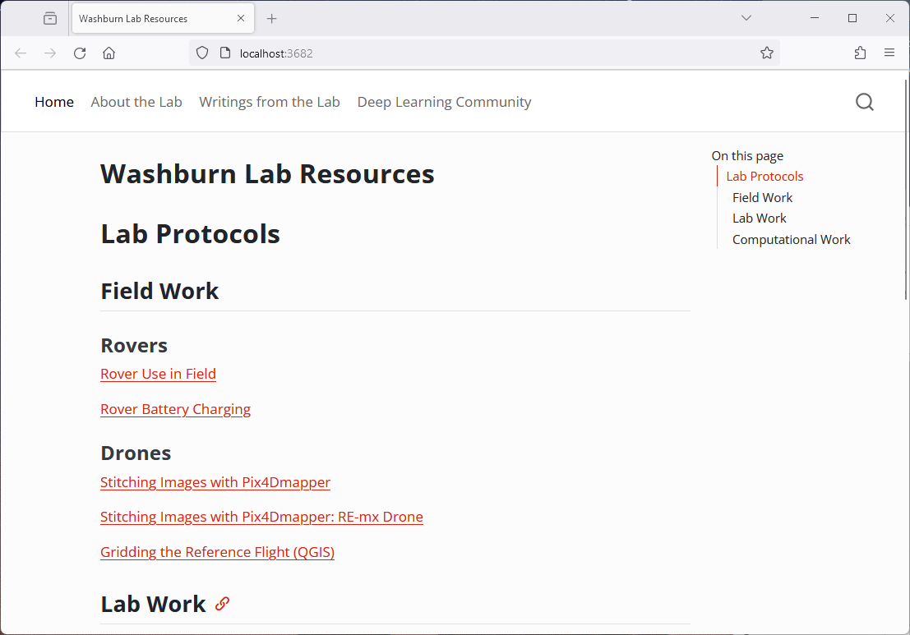
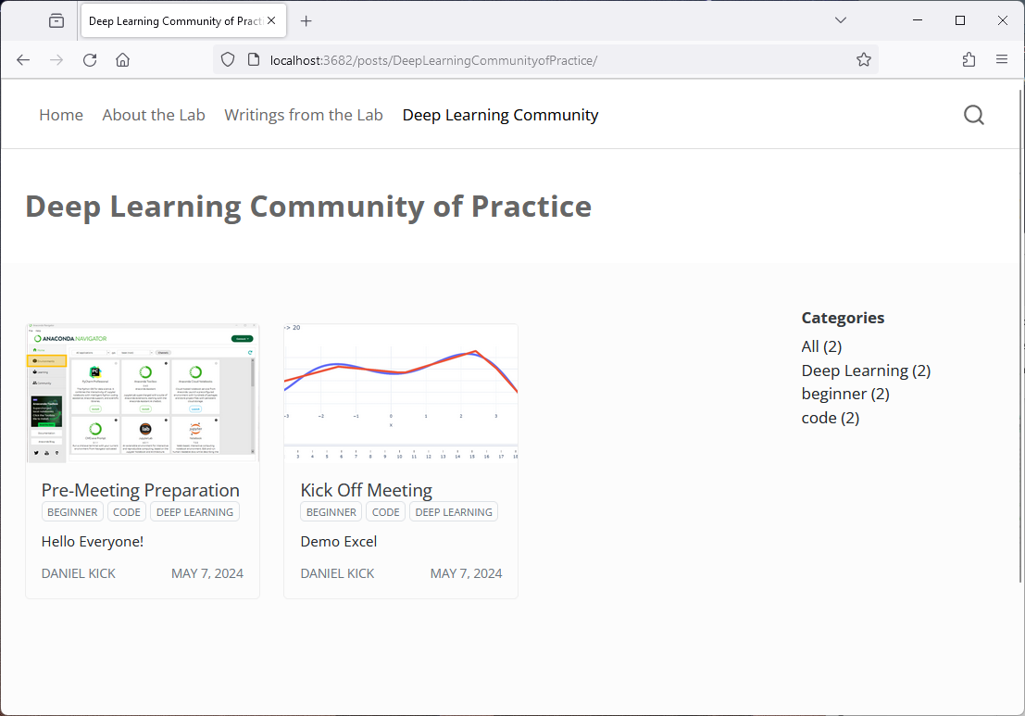
jacobwashburn-usda.github.io/LabProtocols

Slide 3
agenda
Personal Introduction
Discussion Questions
Overview of Deep learning
Material for Next week

Slide 4
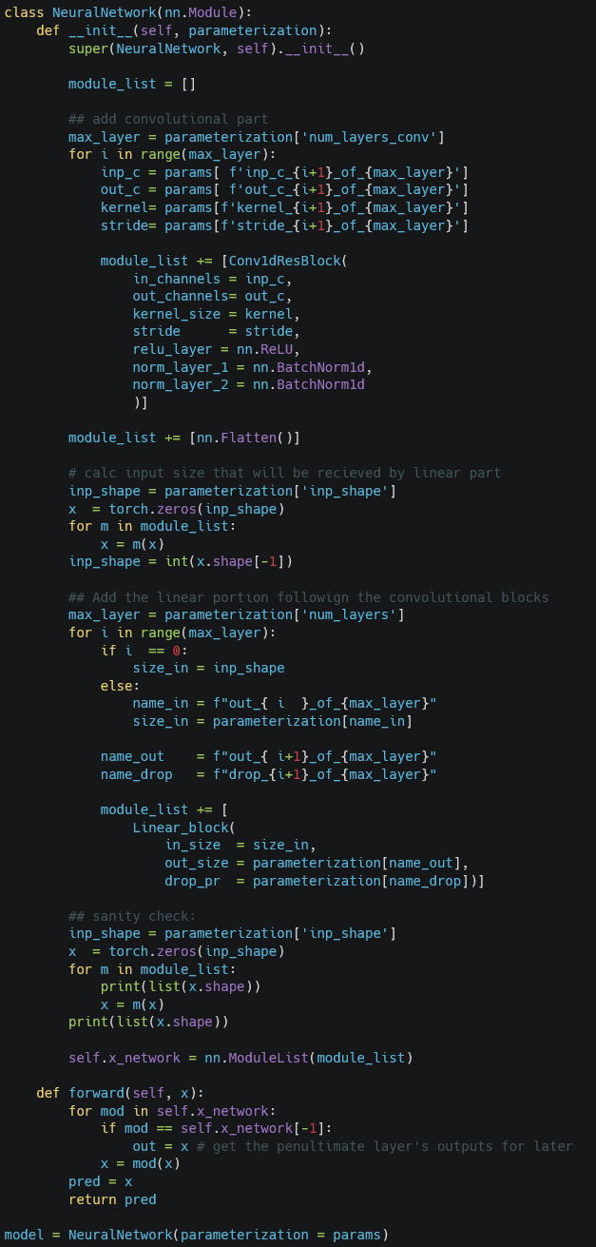
Personal Introduction

Slide 5
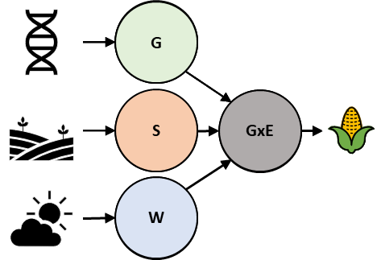
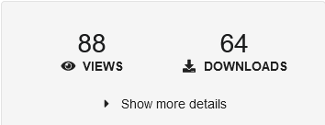
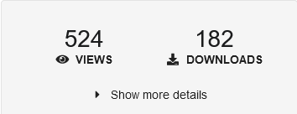
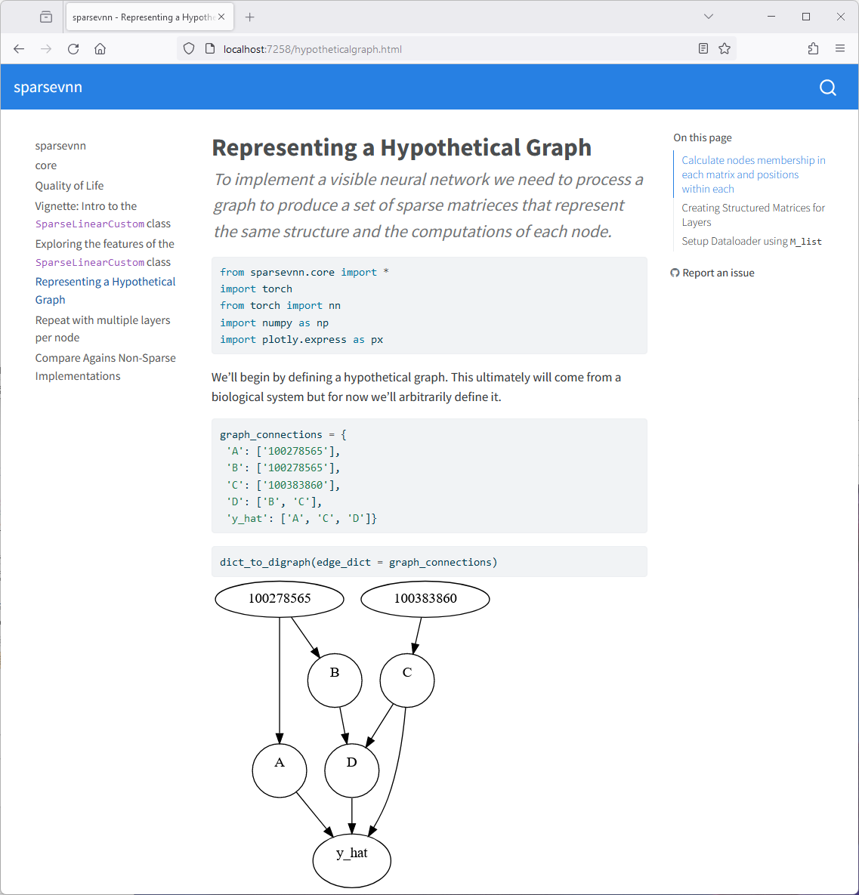
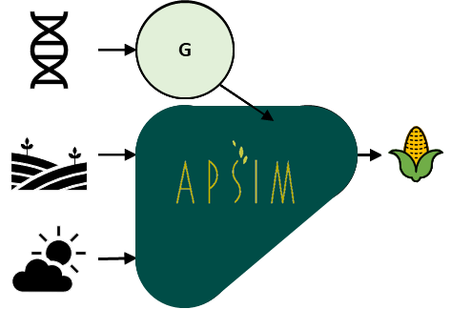
Personal Introduction
Molecular Neurophysiologist ➔ Research Geneticist
Trait Prediction Using Genomic and Environmental Data
Model interpretability
Software Carpentries Instructor

Slide 6
Discussion Questions

Slide 7
Discussion Questions
Are you interested in the low-level details of deep learning or mostly high-level application?
Where do you see yourself using deep learning? In the lab or for personal use?
After learning these topics what goals will you be better situated to achieve?
Are you interested in having a learning partner?

Slide 8
Overview of Deep Learning

Slide 9
Intuition 1 In action Intuition 2

Slide 10
Intuition: Successive Transformation
Combine many nonlinear functions
Change parameters until predictions are close to target
“Depth”
Data
Layer1
…
Layer#
Prediction
$$\hat{y}$$
“y-hat"
“Neuron”
Linear function 1
Nonlinear function
“Hyperparameters”
…
Nonlinear function
“Width”
Linear function #
Nonlinear function

Slide 11
Intuition: Add together linear functions
Plant Stress
Temperature

Slide 12
Intuition: Add together linear functions
y = +1x
Increase slope to decrease error
y = -2x

Slide 13
Intuition: Add together nonlinear functions
y = +1x
Increase slope to decrease error
Remove Negative Values
y = -2x

Slide 14
Intuition 1 In action Intuition 2

Slide 15
In Action
How do we change the parameters to minimize loss?
Parameters
Data
Data
Loss Function
 | Weight 1 | Bias 1
X | 1 | 0 | Out 1 |  |  |  |  |  |  |  |  | yhat | y | Error | SE | MSE
-8 | 1 | 0 | -8 |  |  |  |  |  |  |  |  | -8 | 8 | -16 | 256 | 53.33333
-6 | 1 | 0 | -6 |  |  |  |  |  |  |  |  | -6 | 6 | -12 | 144
-4 | 1 | 0 | -4 |  |  |  |  |  |  |  |  | -4 | 4 | -8 | 64
-2 | 1 | 0 | -2 |  |  |  |  |  |  |  |  | -2 | 2 | -4 | 16
0 | 1 | 0 | 0 |  |  |  |  |  |  |  |  | 0 | 0 | 0 | 0
2 | 1 | 0 | 2 |  |  |  |  |  |  |  |  | 2 | 2 | 0 | 0
4 | 1 | 0 | 4 |  |  |  |  |  |  |  |  | 4 | 4 | 0 | 0
6 | 1 | 0 | 6 |  |  |  |  |  |  |  |  | 6 | 6 | 0 | 0
8 | 1 | 0 | 8 |  |  |  |  |  |  |  |  | 8 | 8 | 0 | 0

Slide 16
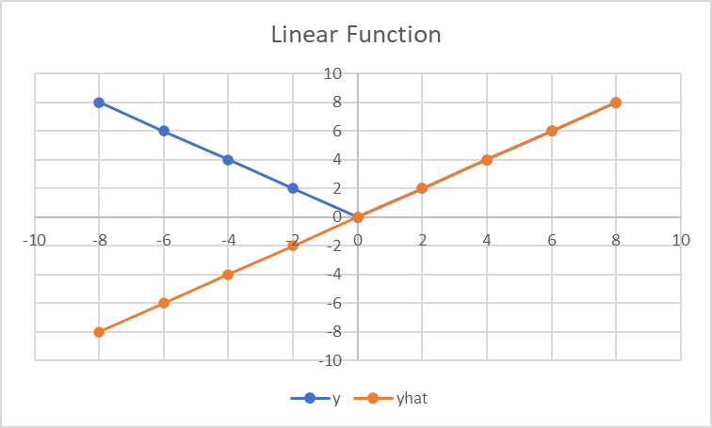
In Action
How do we change the parameters to minimize loss?
 | Weight 1 | Bias 1
X | 1 | 0 | Out 1 |  |  |  |  |  |  |  |  | yhat | y | Error | SE | MSE
-8 | 1 | 0 | -8 |  |  |  |  |  |  |  |  | -8 | 8 | -16 | 256 | 53.33333
-6 | 1 | 0 | -6 |  |  |  |  |  |  |  |  | -6 | 6 | -12 | 144
-4 | 1 | 0 | -4 |  |  |  |  |  |  |  |  | -4 | 4 | -8 | 64
-2 | 1 | 0 | -2 |  |  |  |  |  |  |  |  | -2 | 2 | -4 | 16
0 | 1 | 0 | 0 |  |  |  |  |  |  |  |  | 0 | 0 | 0 | 0
2 | 1 | 0 | 2 |  |  |  |  |  |  |  |  | 2 | 2 | 0 | 0
4 | 1 | 0 | 4 |  |  |  |  |  |  |  |  | 4 | 4 | 0 | 0
6 | 1 | 0 | 6 |  |  |  |  |  |  |  |  | 6 | 6 | 0 | 0
8 | 1 | 0 | 8 |  |  |  |  |  |  |  |  | 8 | 8 | 0 | 0

Slide 17
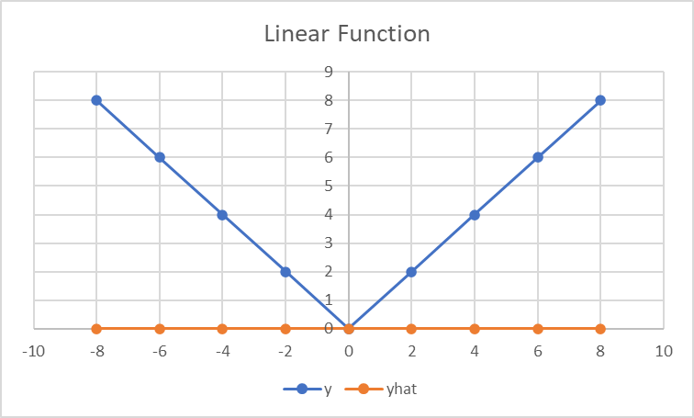
In Action
How do we change the parameters to minimize loss?
 | Weight 1 | Bias 1
X | 0 | 0 | Out 1 |  |  |  |  |  |  |  |  | yhat | y | Error | SE | MSE
-8 | 0 | 0 | 0 |  |  |  |  |  |  |  |  | 0 | 8 | -8 | 64 | 26.66667
-6 | 0 | 0 | 0 |  |  |  |  |  |  |  |  | 0 | 6 | -6 | 36
-4 | 0 | 0 | 0 |  |  |  |  |  |  |  |  | 0 | 4 | -4 | 16
-2 | 0 | 0 | 0 |  |  |  |  |  |  |  |  | 0 | 2 | -2 | 4
0 | 0 | 0 | 0 |  |  |  |  |  |  |  |  | 0 | 0 | 0 | 0
2 | 0 | 0 | 0 |  |  |  |  |  |  |  |  | 0 | 2 | -2 | 4
4 | 0 | 0 | 0 |  |  |  |  |  |  |  |  | 0 | 4 | -4 | 16
6 | 0 | 0 | 0 |  |  |  |  |  |  |  |  | 0 | 6 | -6 | 36
8 | 0 | 0 | 0 |  |  |  |  |  |  |  |  | 0 | 8 | -8 | 64

Slide 18
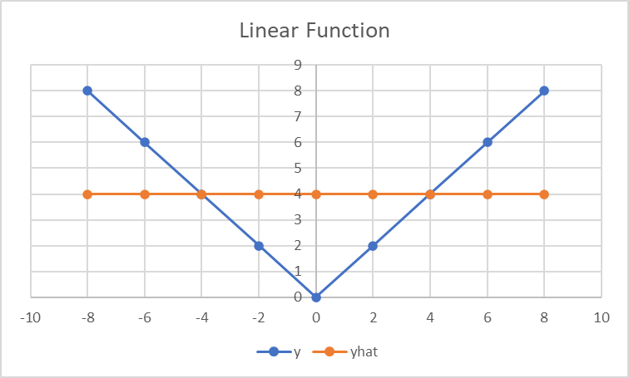
In Action
How do we change the parameters to minimize loss?
How does the loss change if the parameters are changed a little? (gradient)
Nudge the parameters so that loss decreases. (descent)
 | Weight 1 | Bias 1
X | 0 | 4 | Out 1 |  |  |  |  |  |  |  |  | yhat | y | Error | SE | MSE
-8 | 0 | 4 | 4 |  |  |  |  |  |  |  |  | 4 | 8 | -4 | 16 | 7.111111
-6 | 0 | 4 | 4 |  |  |  |  |  |  |  |  | 4 | 6 | -2 | 4
-4 | 0 | 4 | 4 |  |  |  |  |  |  |  |  | 4 | 4 | 0 | 0
-2 | 0 | 4 | 4 |  |  |  |  |  |  |  |  | 4 | 2 | 2 | 4
0 | 0 | 4 | 4 |  |  |  |  |  |  |  |  | 4 | 0 | 4 | 16
2 | 0 | 4 | 4 |  |  |  |  |  |  |  |  | 4 | 2 | 2 | 4
4 | 0 | 4 | 4 |  |  |  |  |  |  |  |  | 4 | 4 | 0 | 0
6 | 0 | 4 | 4 |  |  |  |  |  |  |  |  | 4 | 6 | -2 | 4
8 | 0 | 4 | 4 |  |  |  |  |  |  |  |  | 4 | 8 | -4 | 16
In practice all parameters are shifted at once. Not one at a time.

Slide 19
In Action
 | Weight 1 | Bias 1
X | 0 | 0 | Out 1 |  |  |  |  |  |  |  |  | yhat | y | Error | SE | MSE
-8 | 0 | 0 | 0 |  |  |  |  |  |  |  |  | 0 | 8 | -8 | 64 | 26.66667
-6 | 0 | 0 | 0 |  |  |  |  |  |  |  |  | 0 | 6 | -6 | 36
-4 | 0 | 0 | 0 |  |  |  |  |  |  |  |  | 0 | 4 | -4 | 16
-2 | 0 | 0 | 0 |  |  |  |  |  |  |  |  | 0 | 2 | -2 | 4
0 | 0 | 0 | 0 |  |  |  |  |  |  |  |  | 0 | 0 | 0 | 0
2 | 0 | 0 | 0 |  |  |  |  |  |  |  |  | 0 | 2 | -2 | 4
4 | 0 | 0 | 0 |  |  |  |  |  |  |  |  | 0 | 4 | -4 | 16
6 | 0 | 0 | 0 |  |  |  |  |  |  |  |  | 0 | 6 | -6 | 36
8 | 0 | 0 | 0 |  |  |  |  |  |  |  |  | 0 | 8 | -8 | 64

Slide 20
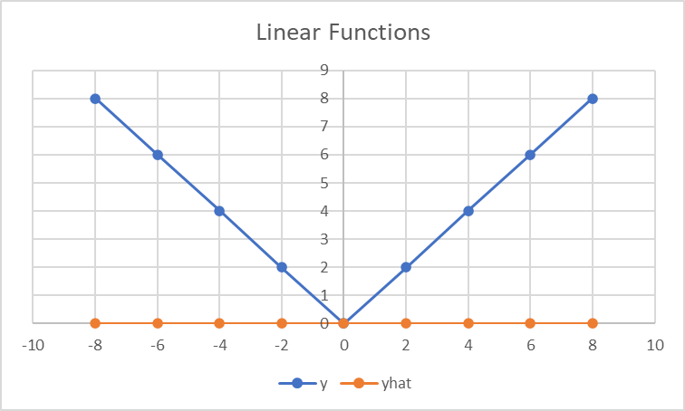
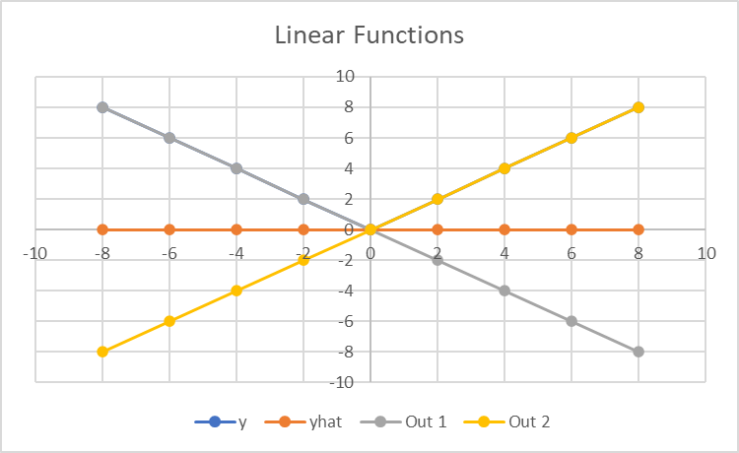
In Action: Two Linear Functions
 | Weight 1 | Bias 1 |  | Weight 2 | Bias 2 |  |  |  | Weight 3 | Bias 3
X | -1 | 0 | Out 1 | 1 | 0 | Out 2 |  |  | 1 | 0 | Out 3 | yhat | y | Error | SE | MSE
-8 | -1 | 0 | 8 | 1 | 0 | -8 |  |  | 1 | 0 | 0 | 0 | 8 | -8 | 64 | 26.66667
-6 | -1 | 0 | 6 | 1 | 0 | -6 |  |  | 1 | 0 | 0 | 0 | 6 | -6 | 36
-4 | -1 | 0 | 4 | 1 | 0 | -4 |  |  | 1 | 0 | 0 | 0 | 4 | -4 | 16
-2 | -1 | 0 | 2 | 1 | 0 | -2 |  |  | 1 | 0 | 0 | 0 | 2 | -2 | 4
0 | -1 | 0 | 0 | 1 | 0 | 0 |  |  | 1 | 0 | 0 | 0 | 0 | 0 | 0
2 | -1 | 0 | -2 | 1 | 0 | 2 |  |  | 1 | 0 | 0 | 0 | 2 | -2 | 4
4 | -1 | 0 | -4 | 1 | 0 | 4 |  |  | 1 | 0 | 0 | 0 | 4 | -4 | 16
6 | -1 | 0 | -6 | 1 | 0 | 6 |  |  | 1 | 0 | 0 | 0 | 6 | -6 | 36
8 | -1 | 0 | -8 | 1 | 0 | 8 |  |  | 1 | 0 | 0 | 0 | 8 | -8 | 64

Slide 21
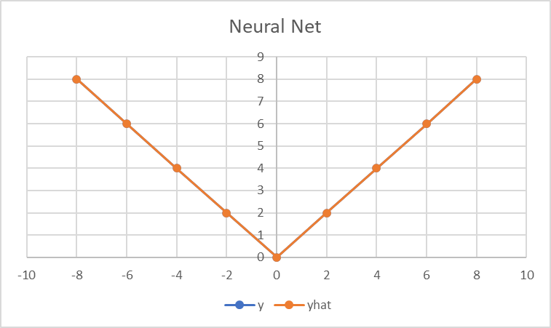
In Action: Non-Linear Functions
 | Weight 1 | Bias 1 |  | Weight 2 | Bias 2 |  |  |  | Weight 3 | Bias 3
X | -1 | 0 | Out 1 | 1 | 0 | Out 2 | Max(0, V1) | Max(0, V2) | 1 | 0 | Out 3 | yhat | y | Error | SE | MSE
-8 | -1 | 0 | 8 | 1 | 0 | -8 | 8 | 0 | 1 | 0 | 8 | 8 | 8 | 0 | 0 | 0
-6 | -1 | 0 | 6 | 1 | 0 | -6 | 6 | 0 | 1 | 0 | 6 | 6 | 6 | 0 | 0
-4 | -1 | 0 | 4 | 1 | 0 | -4 | 4 | 0 | 1 | 0 | 4 | 4 | 4 | 0 | 0
-2 | -1 | 0 | 2 | 1 | 0 | -2 | 2 | 0 | 1 | 0 | 2 | 2 | 2 | 0 | 0
0 | -1 | 0 | 0 | 1 | 0 | 0 | 0 | 0 | 1 | 0 | 0 | 0 | 0 | 0 | 0
2 | -1 | 0 | -2 | 1 | 0 | 2 | 0 | 2 | 1 | 0 | 2 | 2 | 2 | 0 | 0
4 | -1 | 0 | -4 | 1 | 0 | 4 | 0 | 4 | 1 | 0 | 4 | 4 | 4 | 0 | 0
6 | -1 | 0 | -6 | 1 | 0 | 6 | 0 | 6 | 1 | 0 | 6 | 6 | 6 | 0 | 0
8 | -1 | 0 | -8 | 1 | 0 | 8 | 0 | 8 | 1 | 0 | 8 | 8 | 8 | 0 | 0

Slide 22
Intuition 1 In action Intuition 2

Slide 23
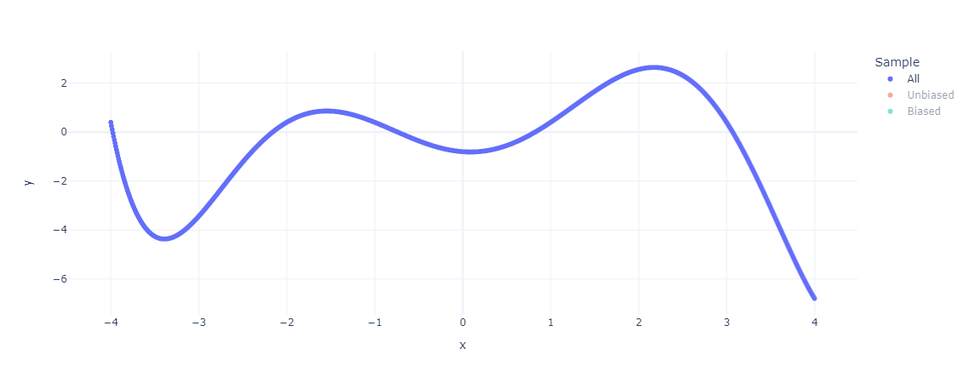
Intuition: Network Capacity

Slide 24
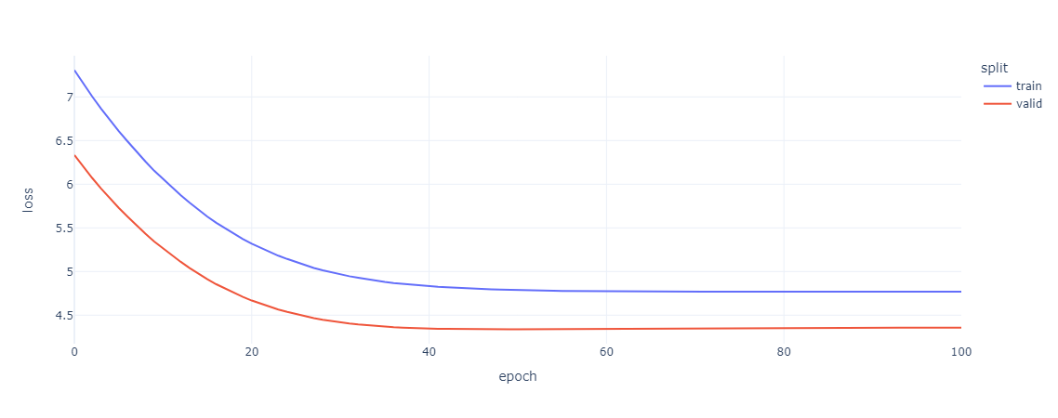
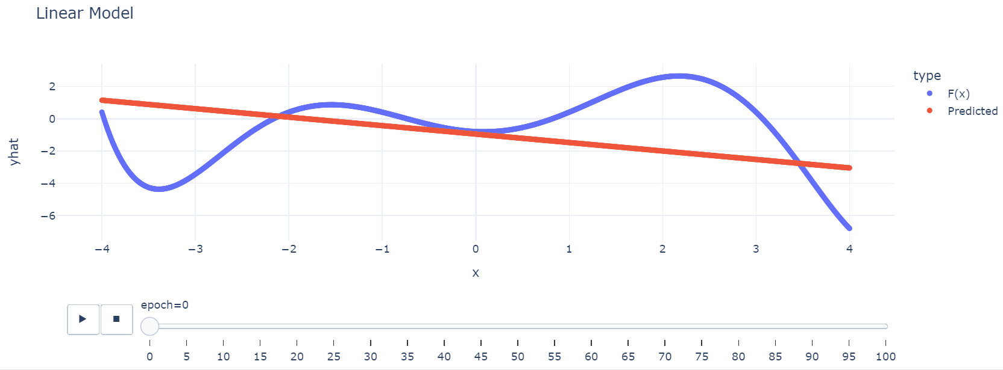
Linear: Okay Fit

Slide 25
Nonlinear: Better Fit

Slide 26
More Units: Better Fit

Slide 27
More Units & Layers: Better Fit (Sometimes)

Slide 28
Material for Next week

Slide 29
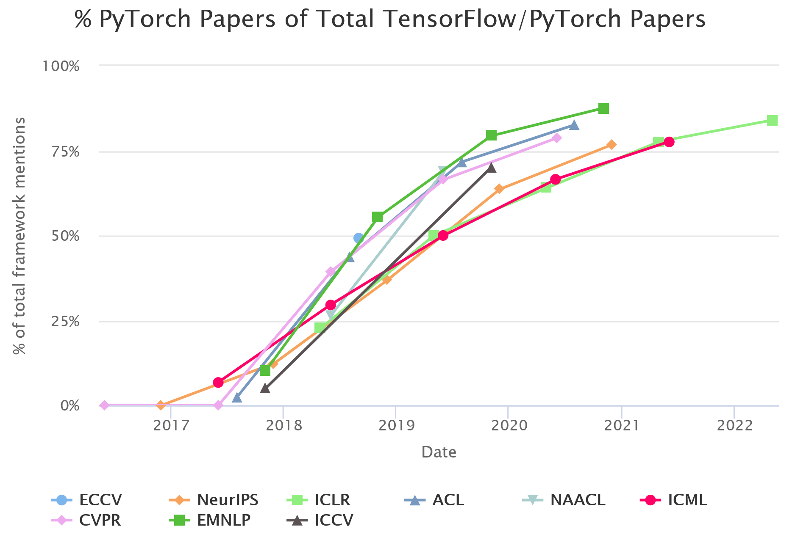
Journal Club Introduction
Focus on concepts over frameworks
Frameworks change, theory builds
Build from basics aiming towards transformers
Notebooks for fast feedback and high accessibility
https://miguelgfierro.com/blog/2022/an-analysis-of-the-adoption-of-top-deep-learning-frameworks/

Slide 30
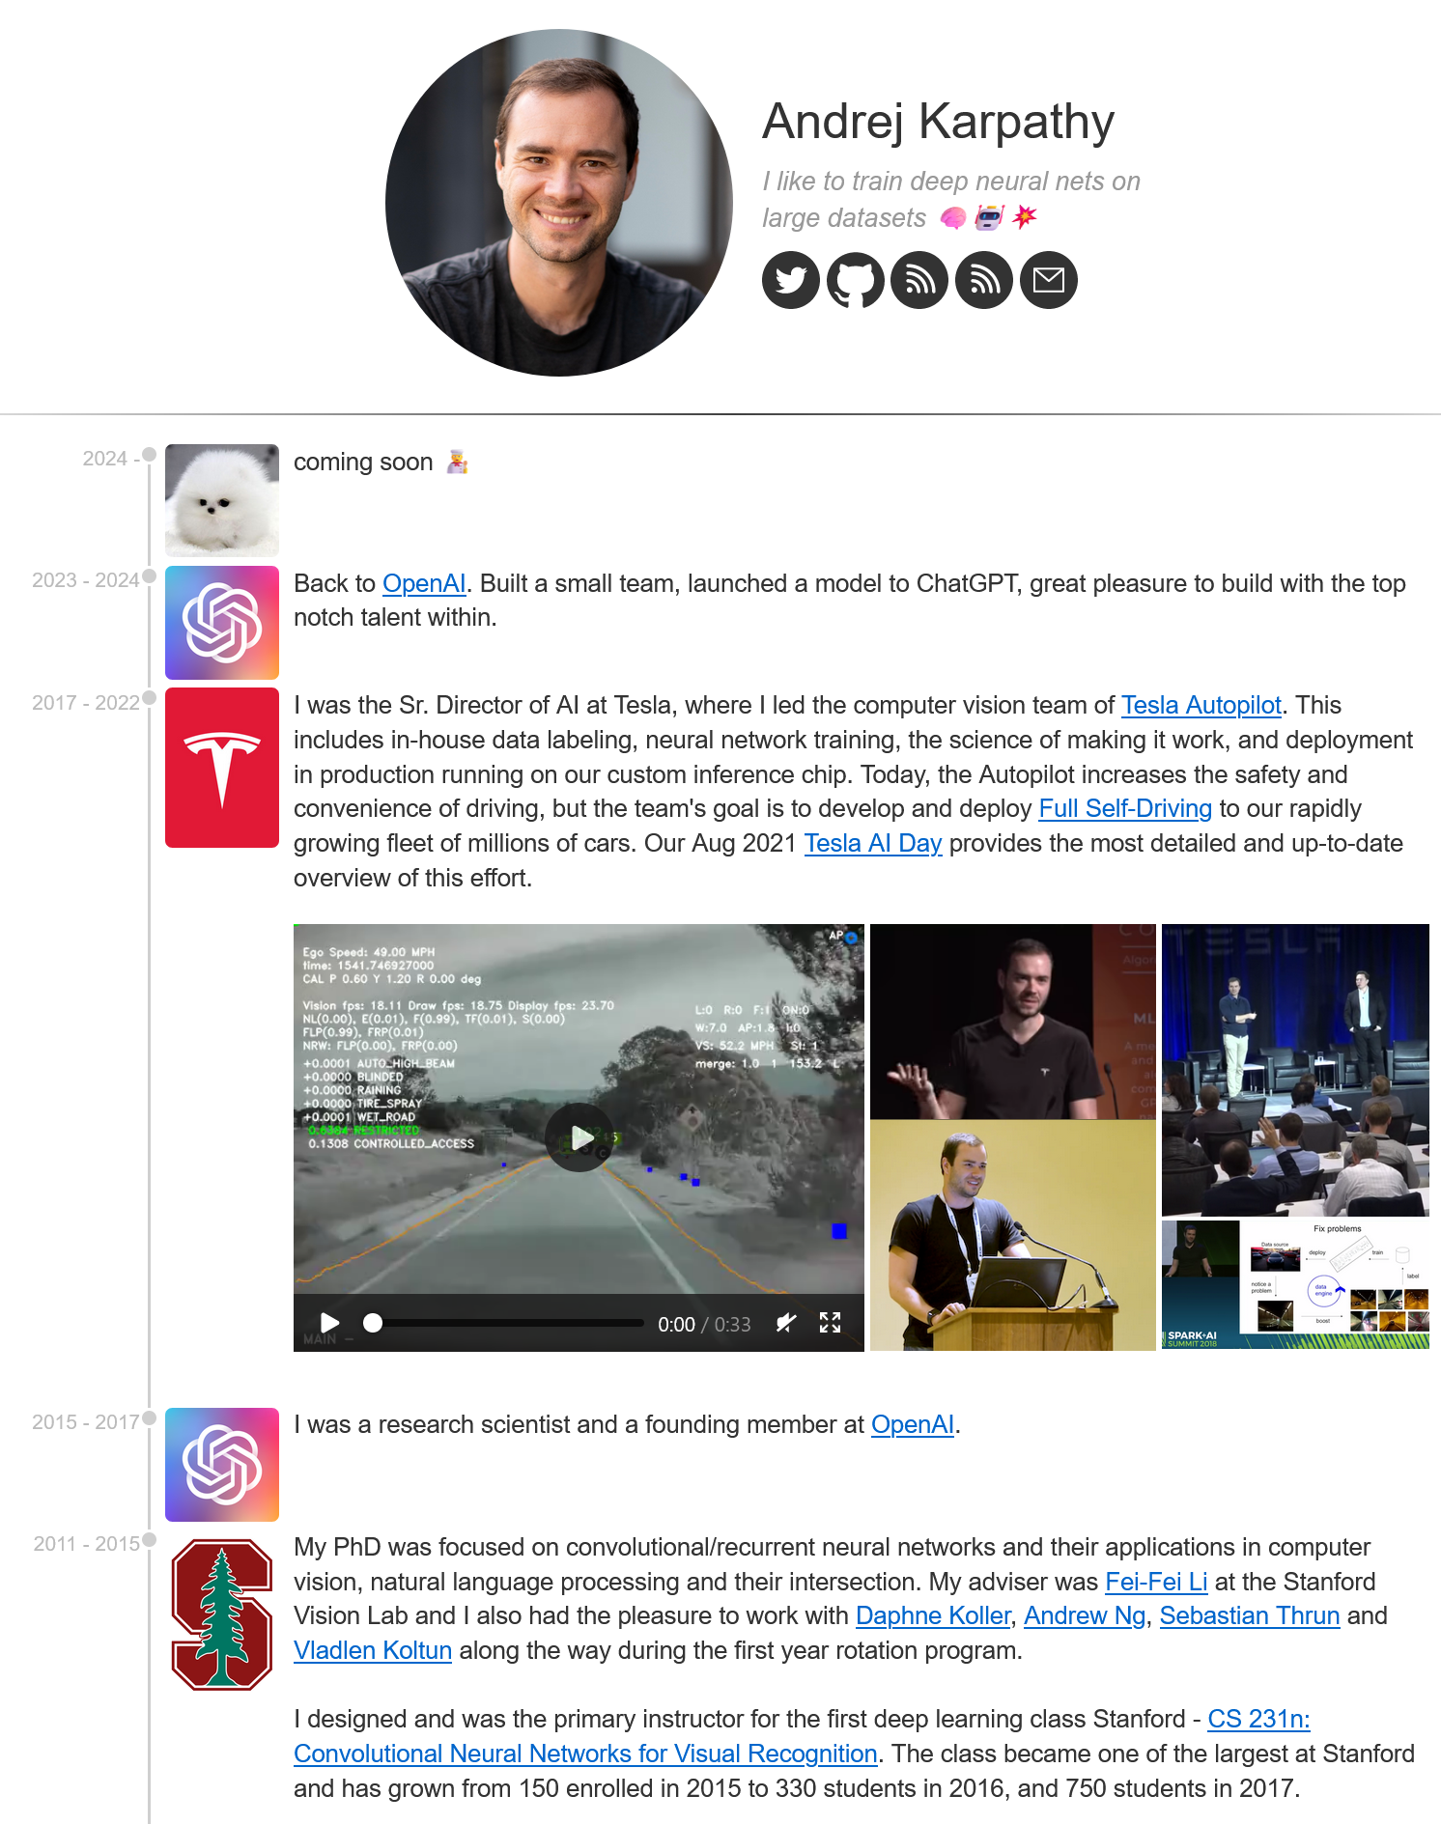
Initial Plan:
Back propagation: The spelled-out intro to neural networks and backpropagation: building micrograd
Watch at least to 1h22m. by next week and the full video by the next meeting.
Take notes in your Jupyter notebook, ideally transcribe and run portions of the code.
Note what is confusing, what insights you have
You will need: numpy, matplotlib, graphviz
NOTE: if using conda on windows `graphviz` must be installed with pip! (in a notebook cell run “! pip install graphviz”)
We can discuss other resources and supplementary material in future sessions.

Slide 31
An Insufficient introduction to Python
Objects
Python bundles data and methods together into objects.
The definition for an object uses the keyword “class” whereas the definition of a function uses “def”
Attributes and methods of an object are accessed with a “.”
myData.shape # attribute
myData.mean() # method
Underscores
Some methods or begin with two underscores (“dunder” e.g. __init__). These are special methods that python uses.
Some methods begin with one underscore. By convention these are not meant to be used outside of a class. (Think personal notes vs public communication)

Slide 32
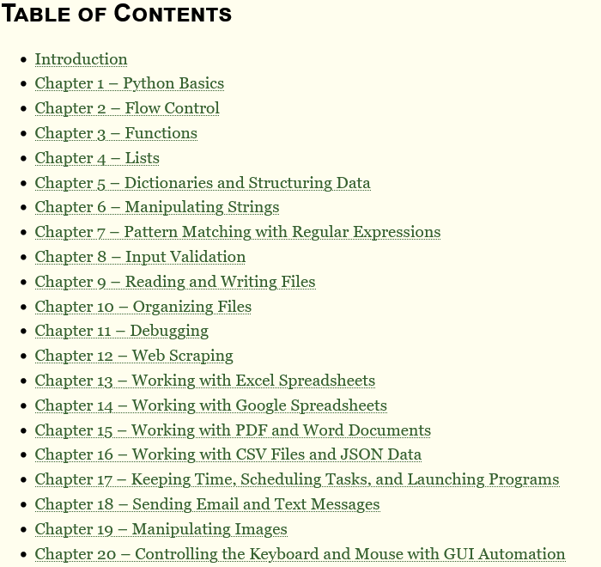
Getting help
Tutorials
Learn X in Y minutes
Automate the Boring Stuff
Software Carpentry
Data Carpentry
Official Tutorial
Specific Questions
Stack Overflow
Lab members!

Slide 33
THANK YOU!

