Slide 1
Deep Learning Community of Practice Meeting 4

Slide 2
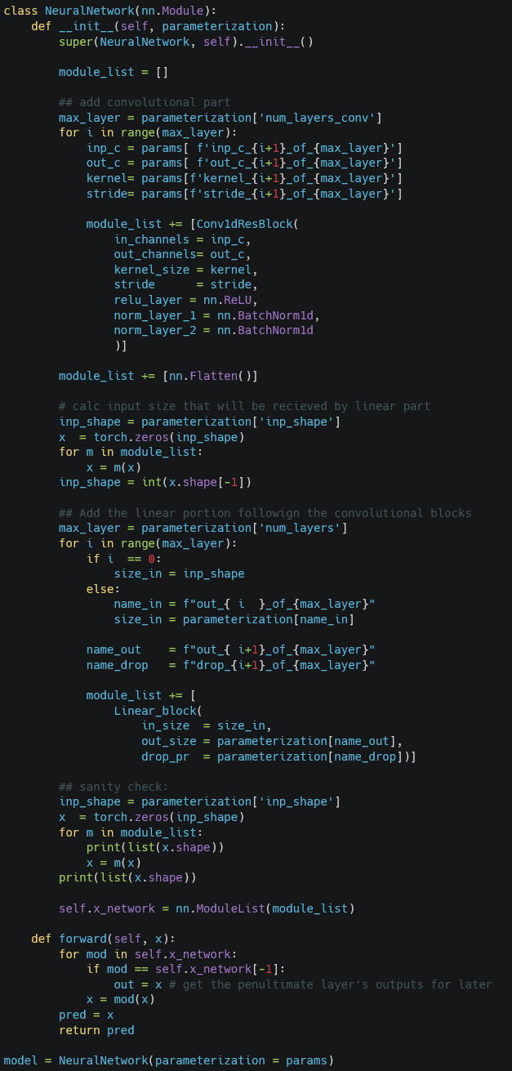
Initialization

Slide 3
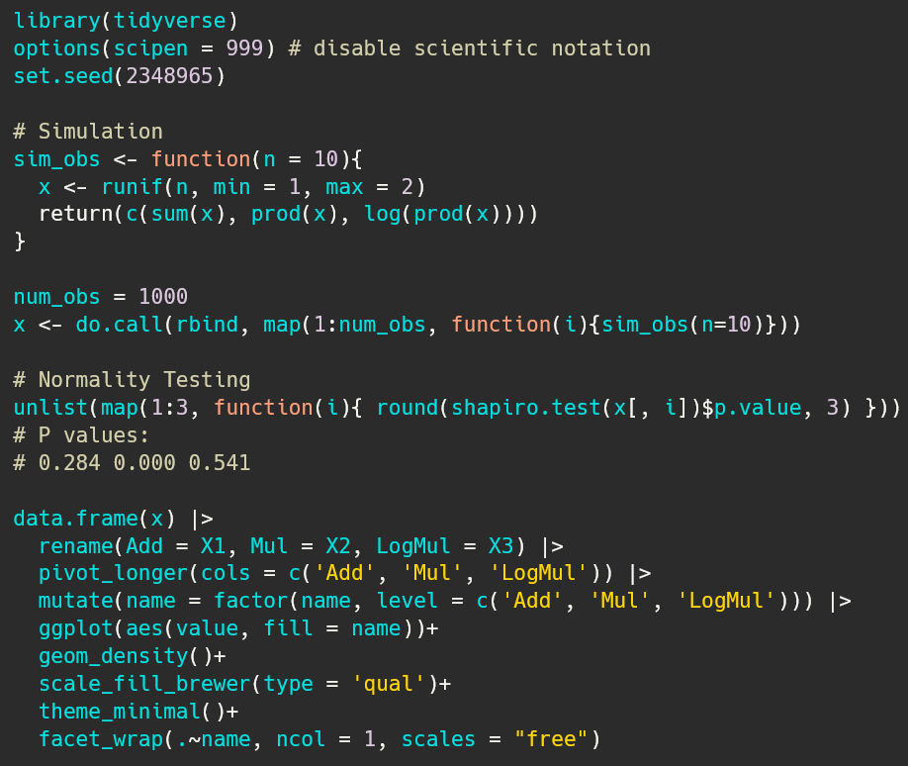
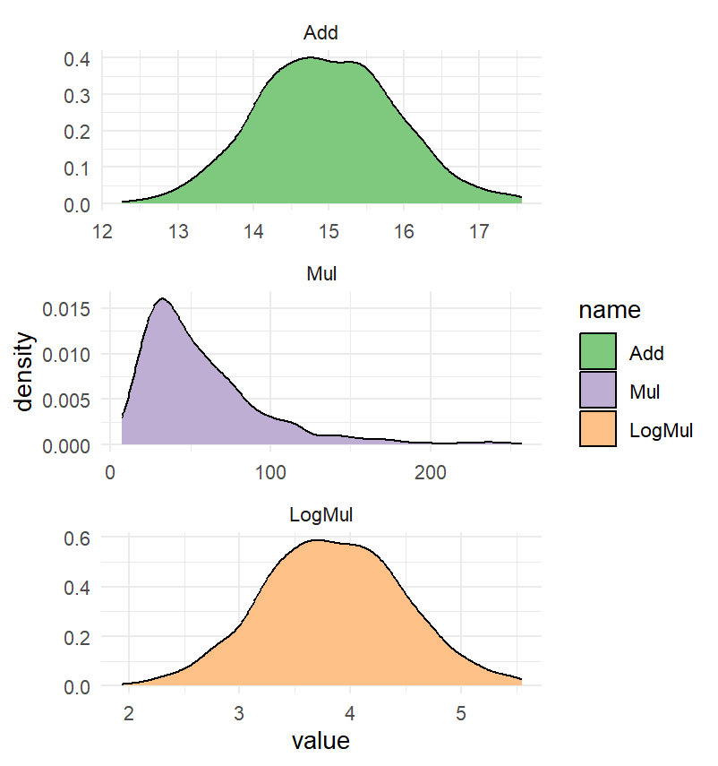
Connection to traditional statistics: Testing Assumptions and Transforming Y
See also: Statistical Rethinking 4.1 Why normal distributions are normal

Slide 4
Setting Up the Next Section: Motivating Puzzls

Slide 5
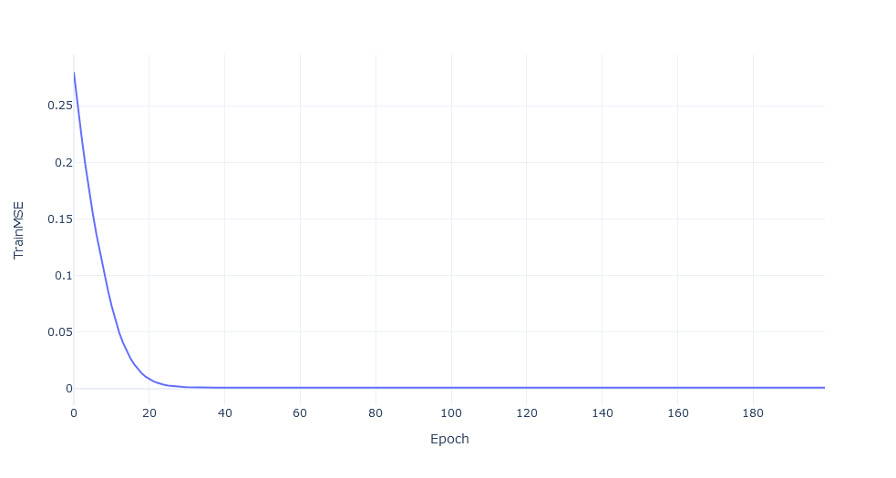
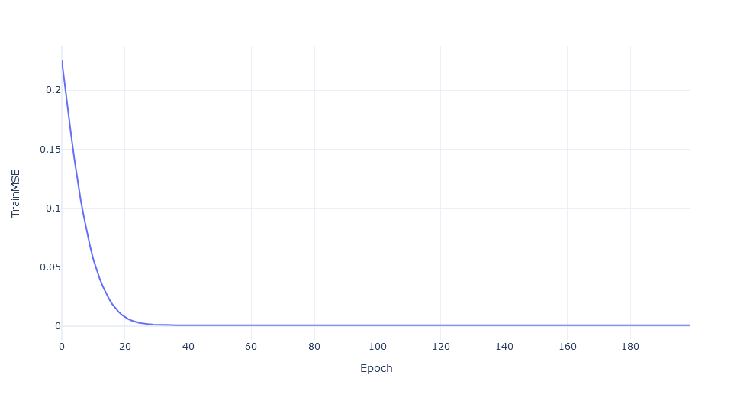
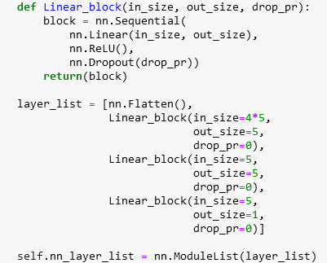
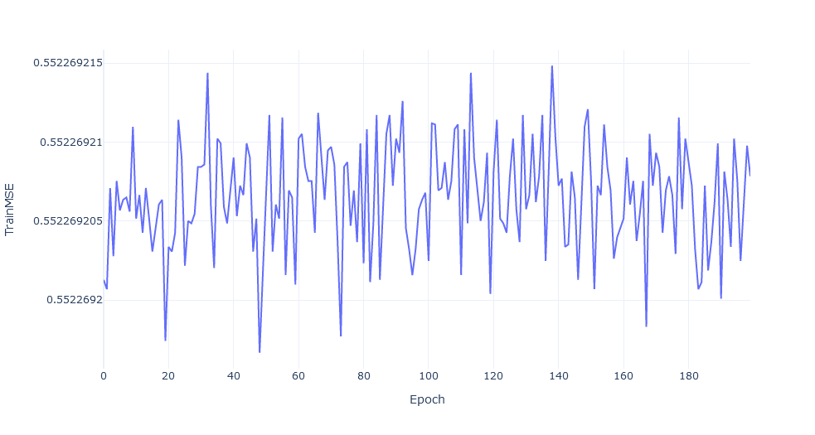
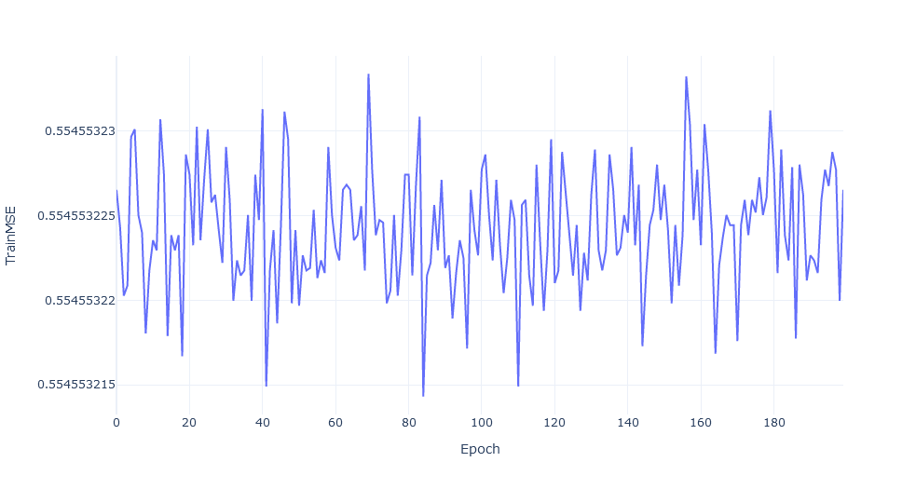
Motivating Puzzle: Simple MLP fails to learn inconsistently
y_true a1_input a2_input
[1], [[0, … ], [0, … ]]
[0], [[1, … ], [1, … ]]
No Noise
2000 obs., batch 20

Slide 6
For Next Session: Option 1: Revisiting Backprop. and Wavenet Option 2: Only Wavenet

Slide 7
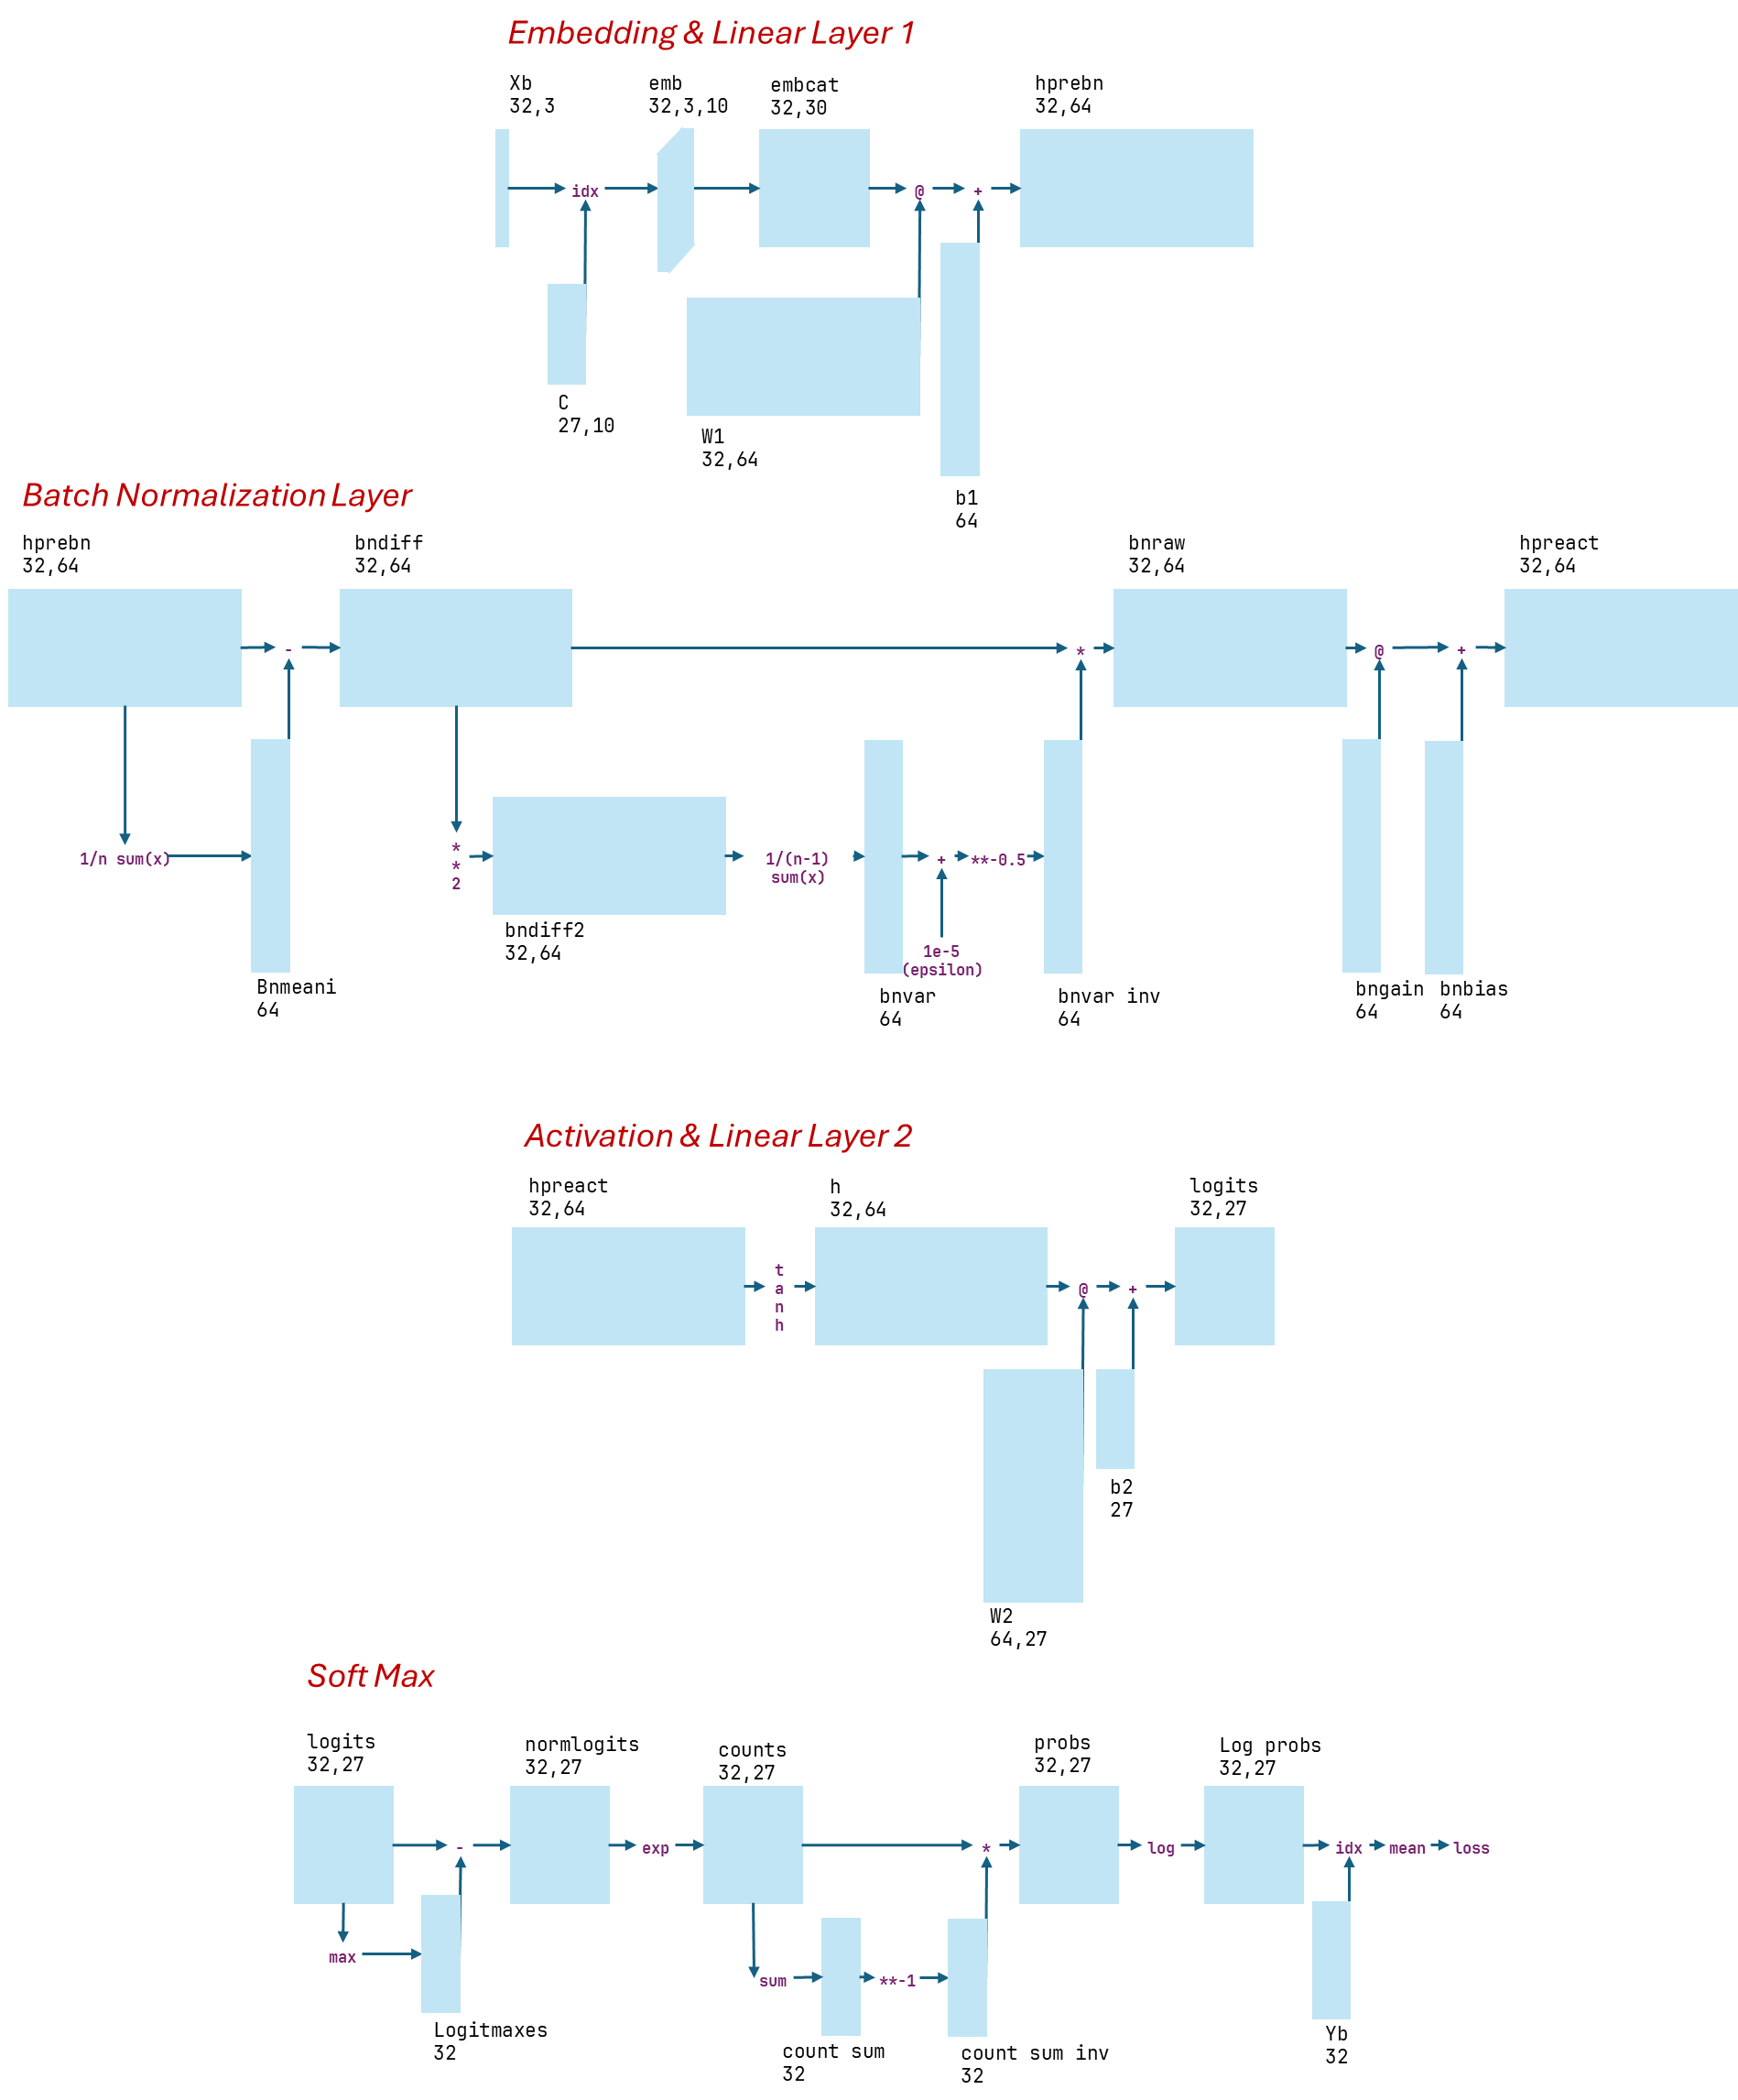
Option 1: Revisiting Backpropagation Low Level

Slide 8
Why does Batch Norm work?

Slide 9
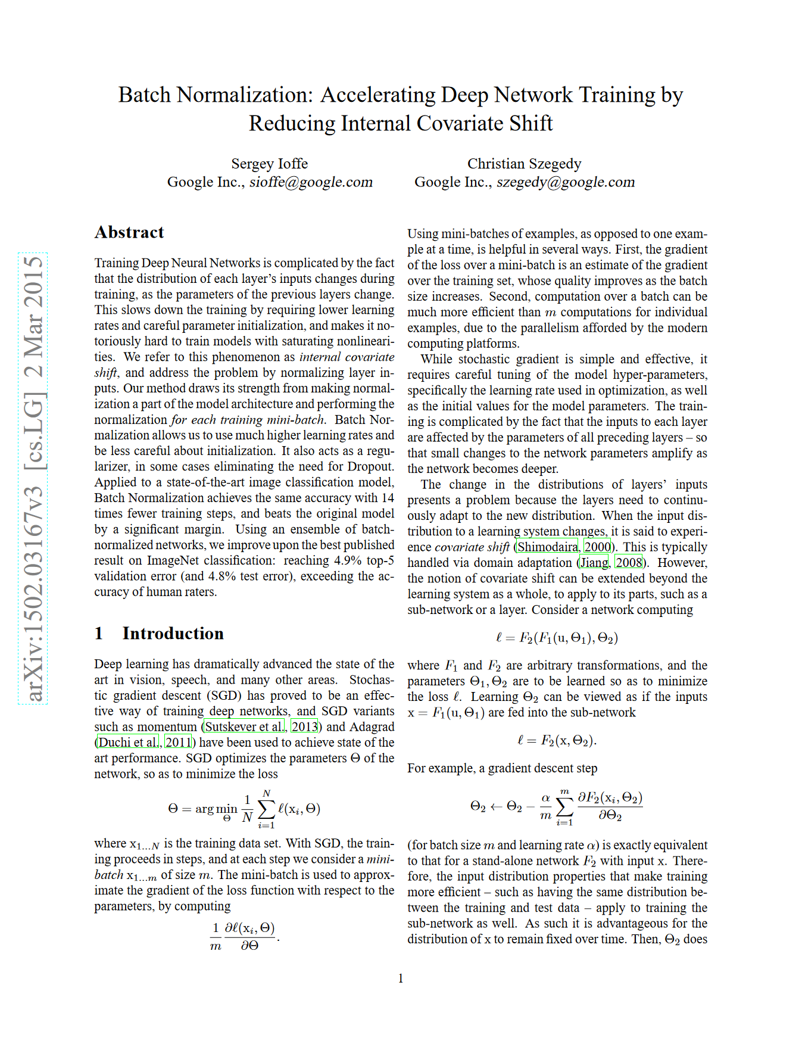
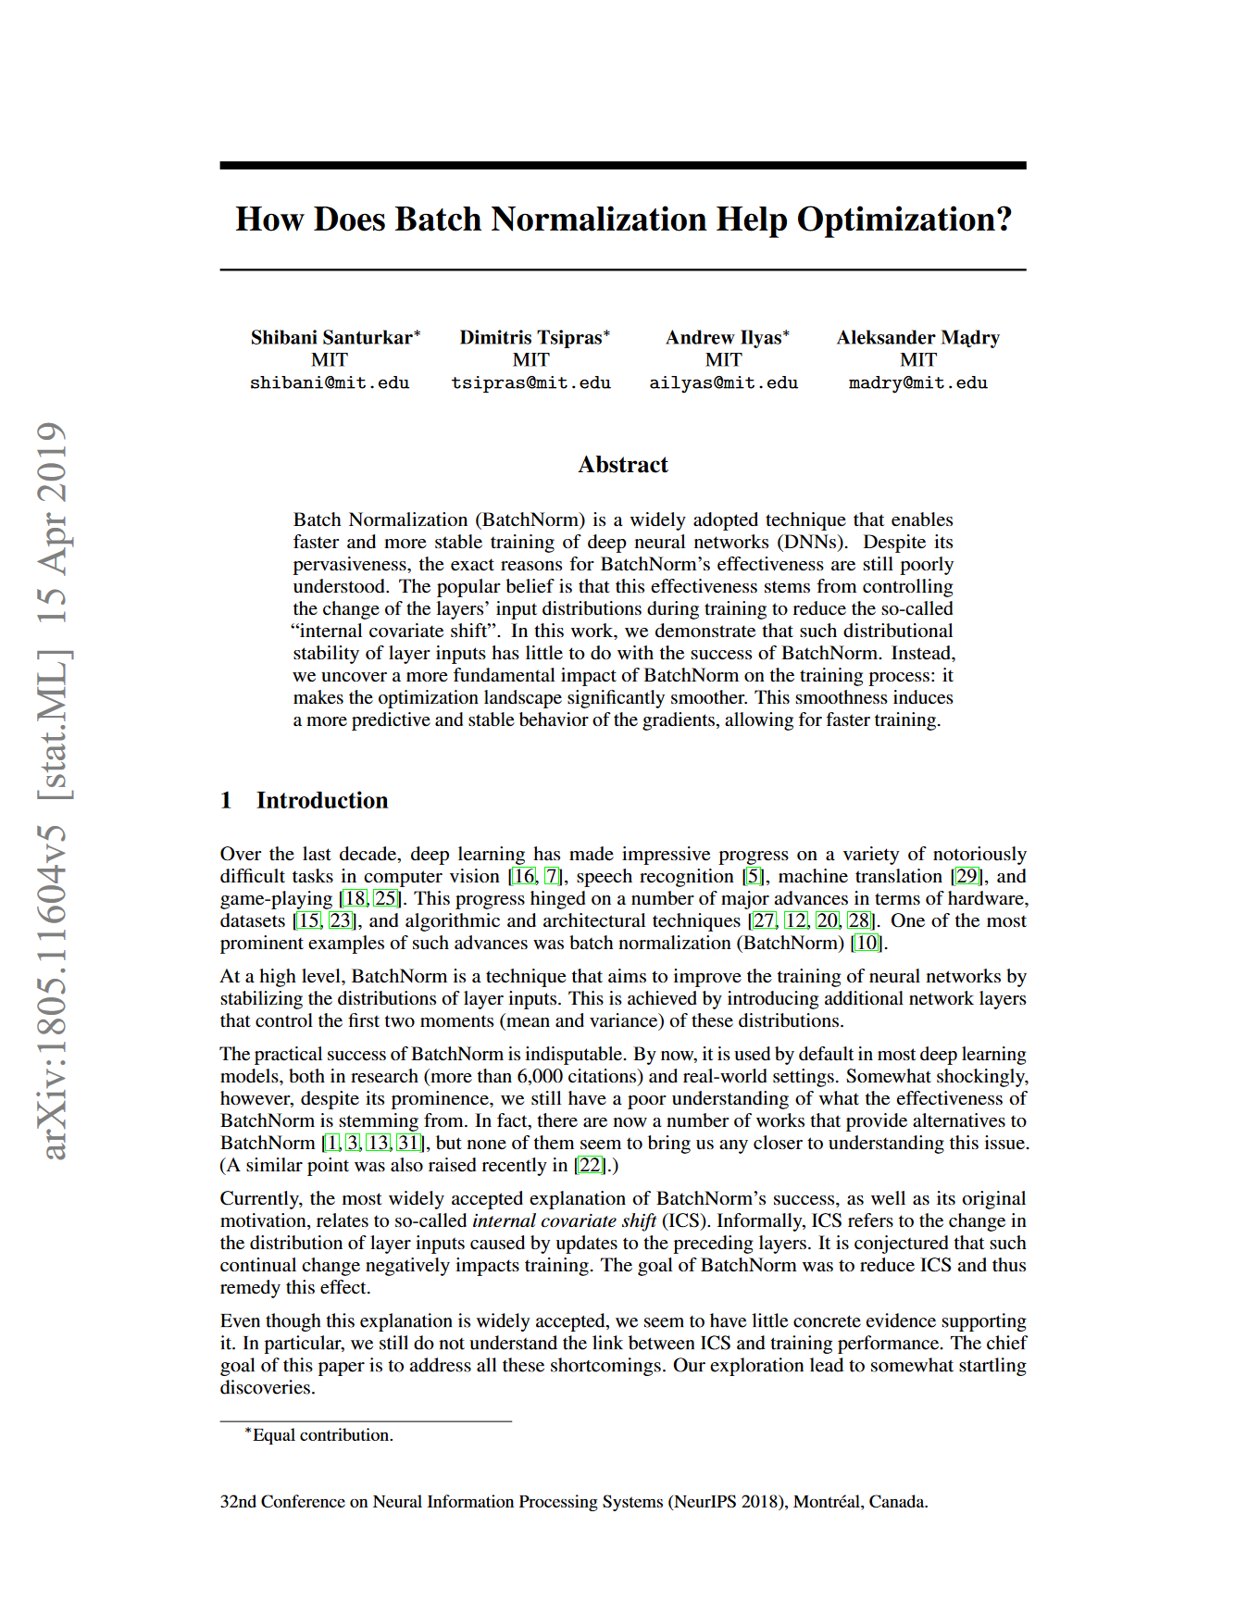
Why does Batch Norm work?
https://arxiv.org/abs/1502.03167
https://arxiv.org/abs/1805.11604

Slide 10
Visualizing Internal Covariance Shift
Training with a large LR
With Batch Norm (LR 0.5) isn’t prohibitively large
But differences in layer weight distribution change over training is small in both case (?!)

Slide 11
Experiment: Induce Internal Covariance Shift
Layer
Non-Linearity
Ref. ICS (Presumed)
Layer
Batch Norm
Non-Linearity
Low ICS (Presumed)
Layer
Batch Norm
Non-Linearity
High ICS (Known)
Non-unit Noise

Slide 12
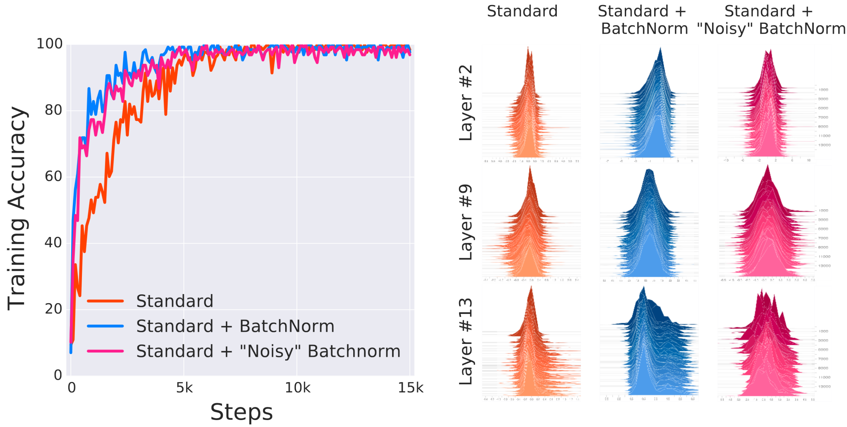
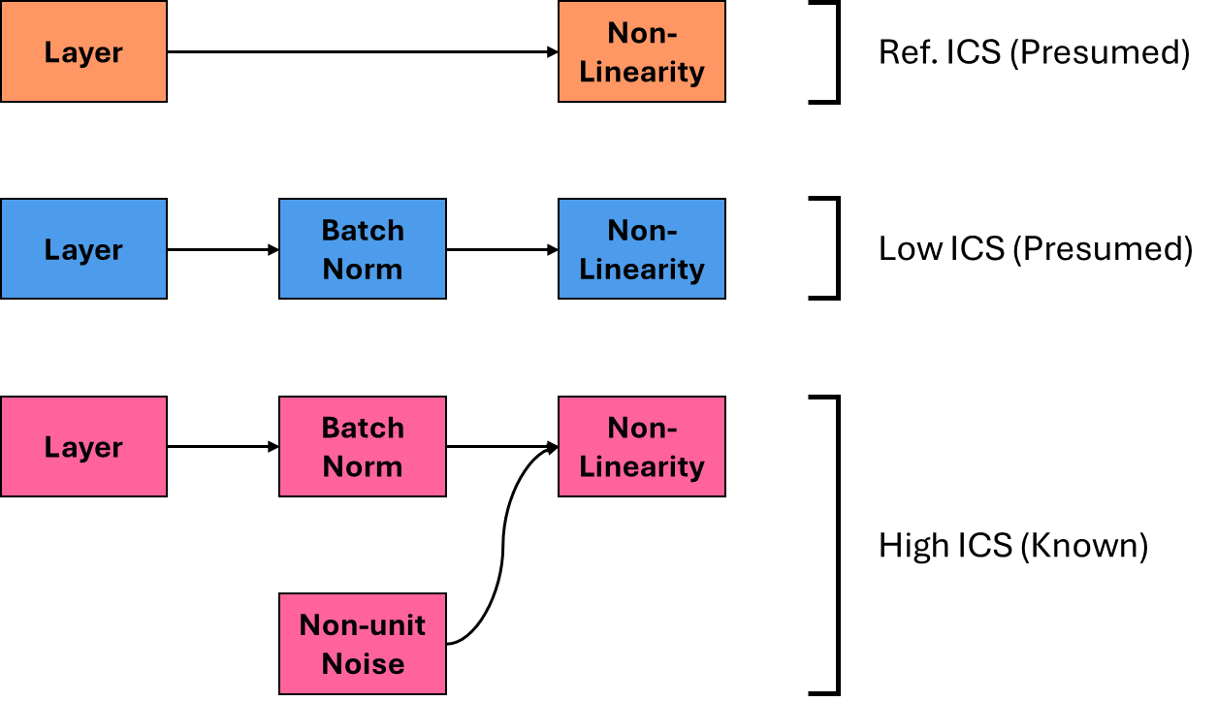
High Internal Covariance Shift - Still Trains
Despite High ICS, Batch Norm Trains faster than Standard

Slide 13
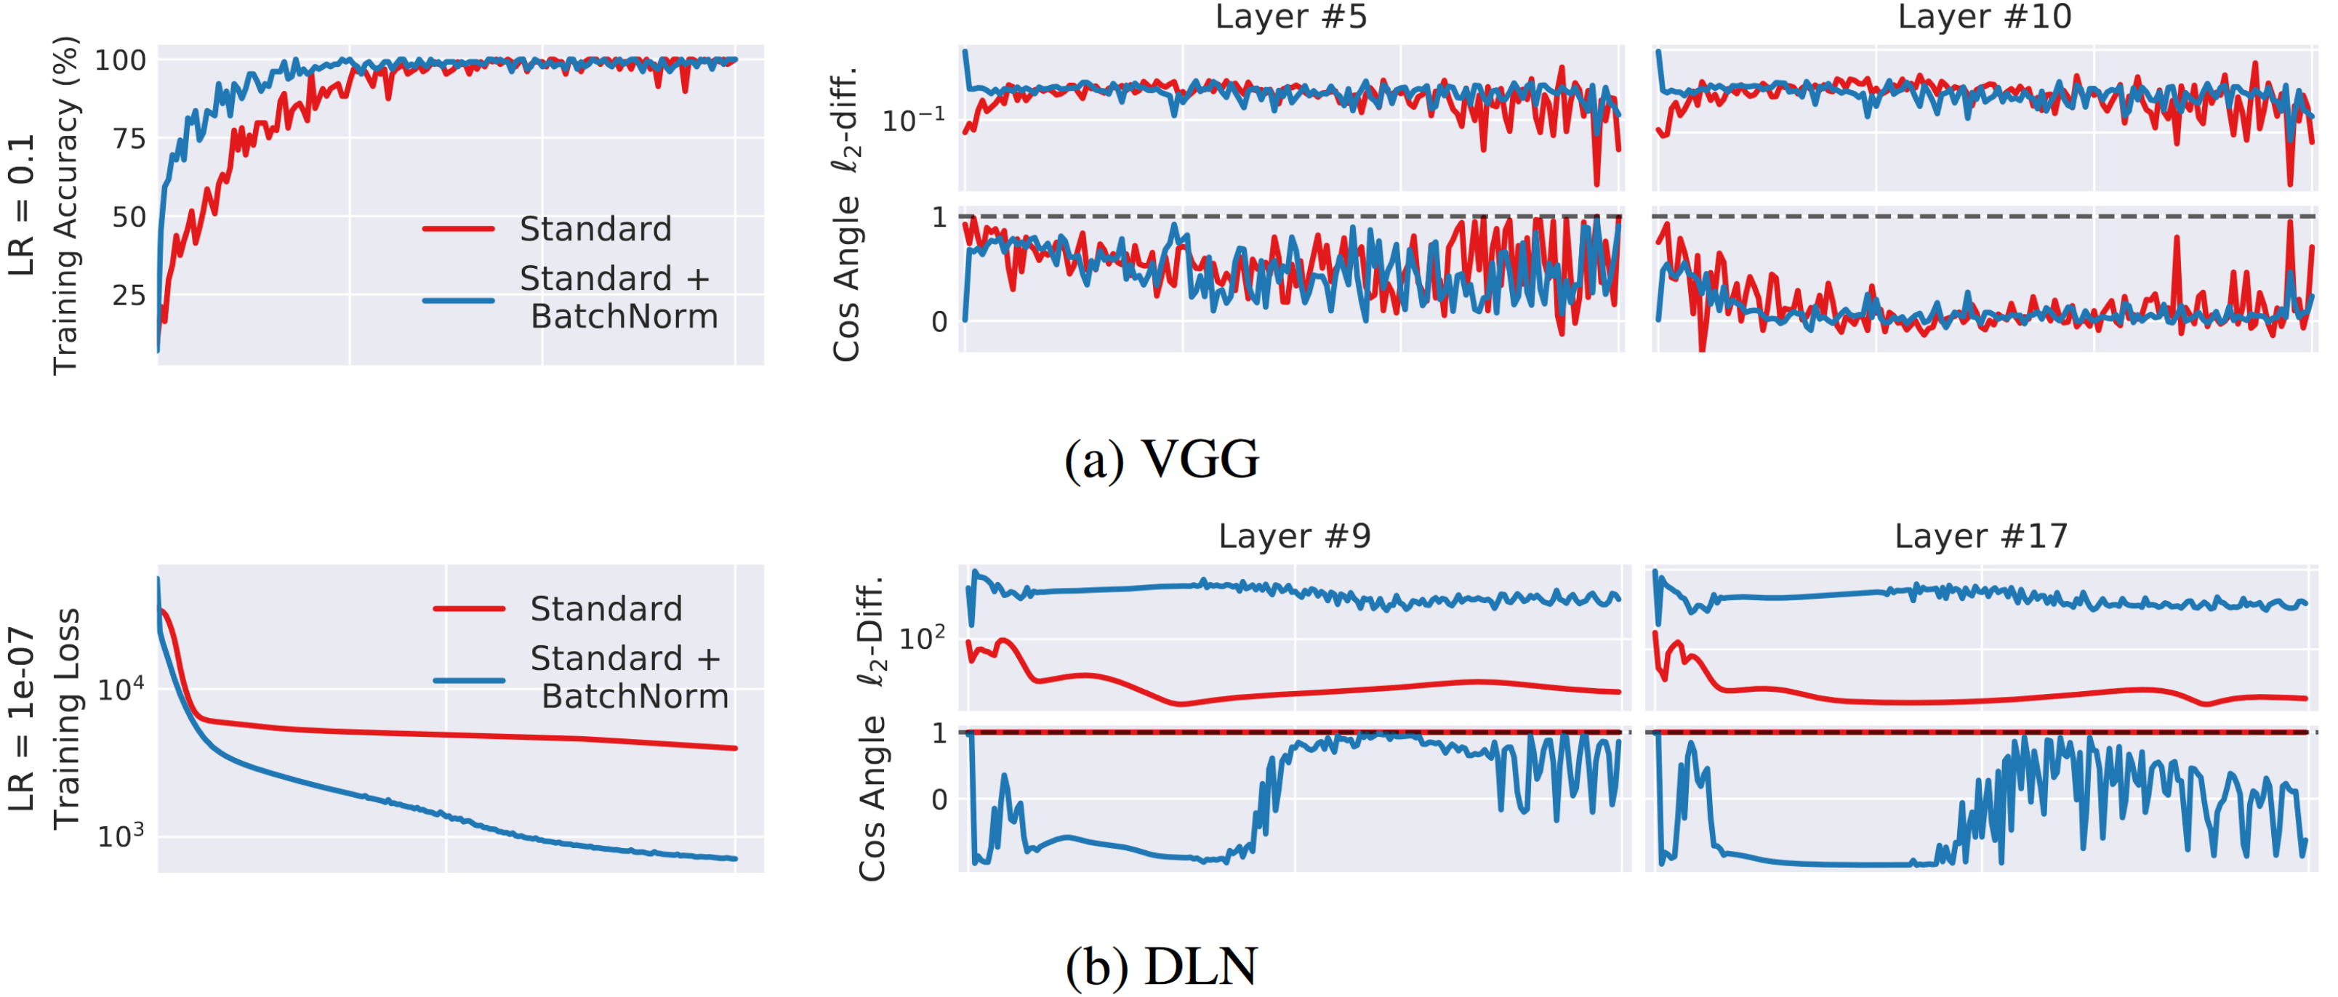
Quantifying Internal Covariance Shift
Model 1
>= ICS
No ICS
Higher
Accuracy
>= ICS
Model 2
>= ICS
Lower Loss

Slide 14
So Why does it work?
Batch Norm reduces the range of losses (“smoothness”)

Slide 15
Aside on ResNets and More to Explore

Slide 16
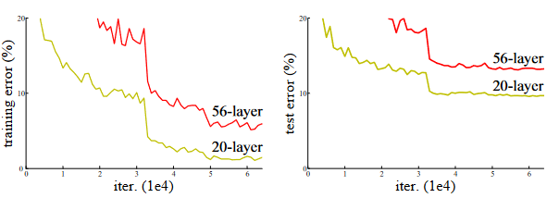
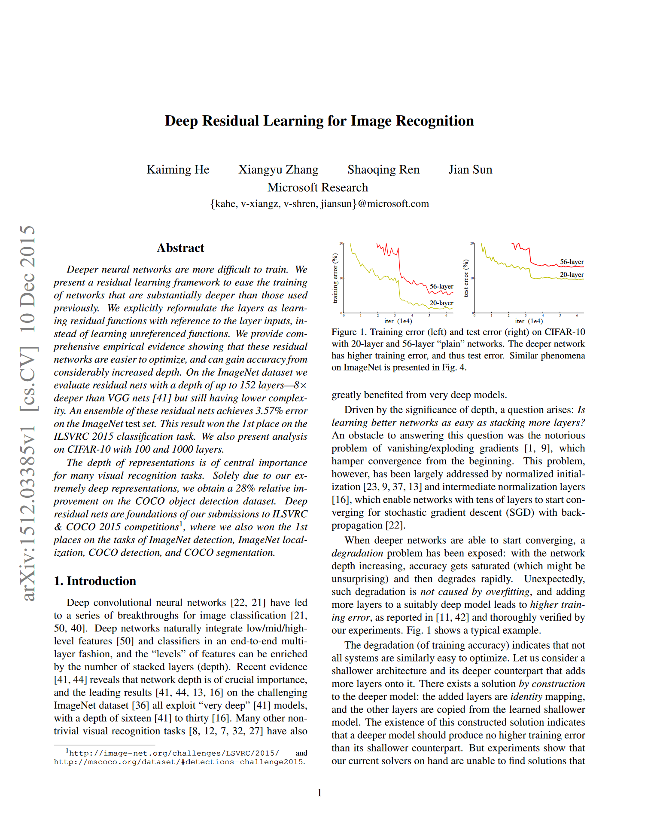
Context: Deep Networks should outperform shallow ones
With (weight 1, bias 0) no change will occur (identity layer)
Every n layer network can be represented as a larger network with arbitrarily many identity layers
Therefore, a network with n+1 layers should perform at least as well as a network with n layers.
https://arxiv.org/pdf/1512.03385v1

Slide 17
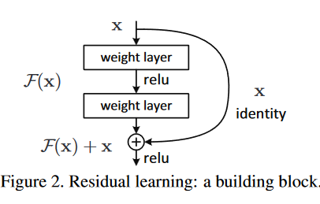
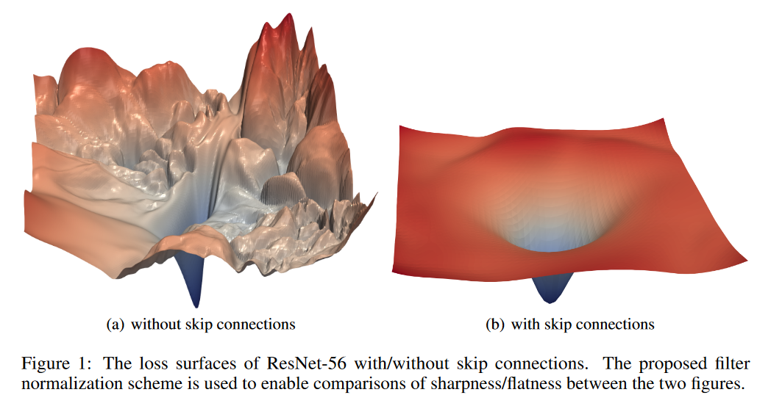
Context: Deep Networks should outperform shallow ones
Adding “shortcut” residual connections improves performance
https://arxiv.org/pdf/1512.03385v1
https://arxiv.org/abs/1712.09913

Slide 18
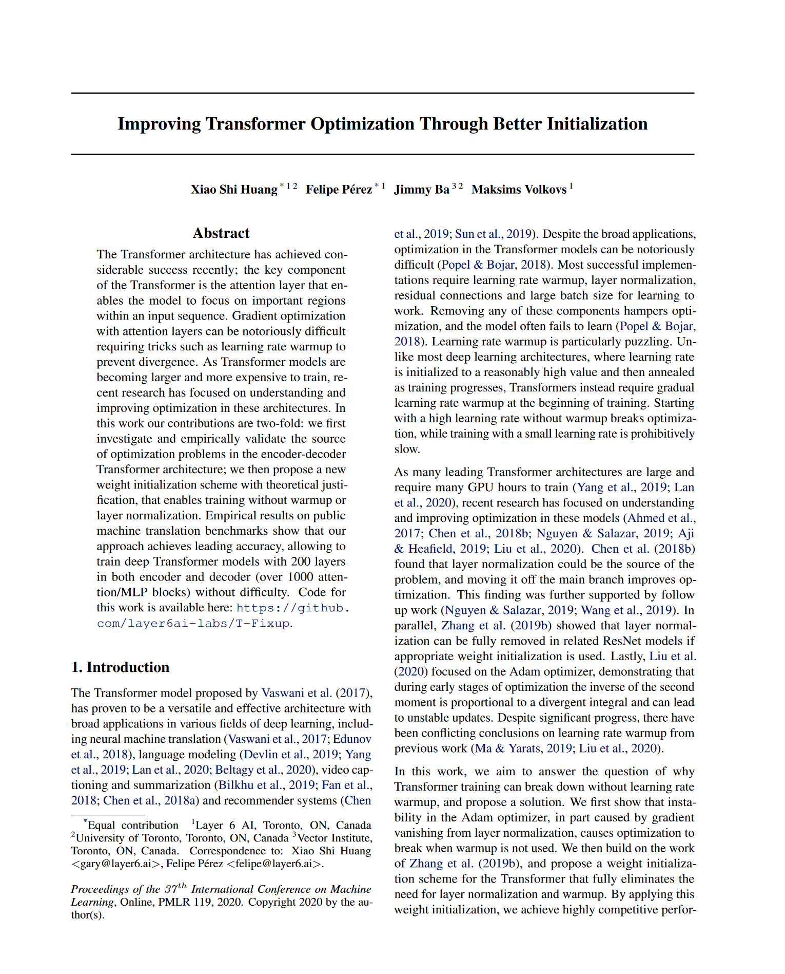
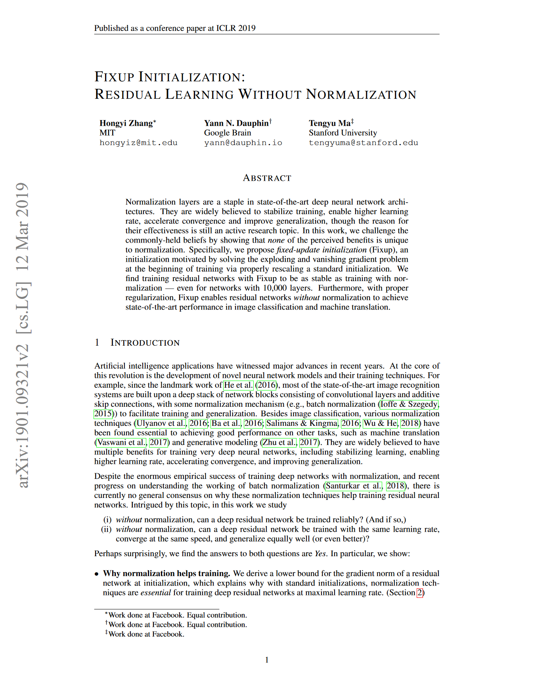
More to Explore: Initialization for Resnets and Transformers with
https://arxiv.org/pdf/1901.09321
http://proceedings.mlr.press/v119/huang20f/huang20f.pdf

