Slide 1
Deep Learning Community of Practice Kick Off Meeting
Daniel Kick, Coordinator

Slide 2
Agenda
Introduction
Personal Introduction
Thinking Questions
Fall Overview
Using Python for Science
Why Python?
A Jupyter Based Workflow
Example Use

Slide 3
Introduction

Slide 4
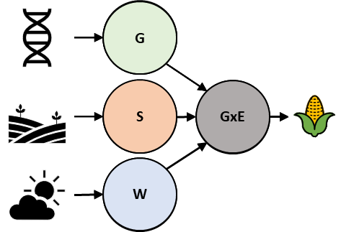
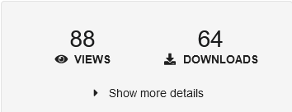
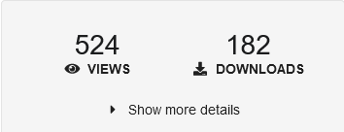
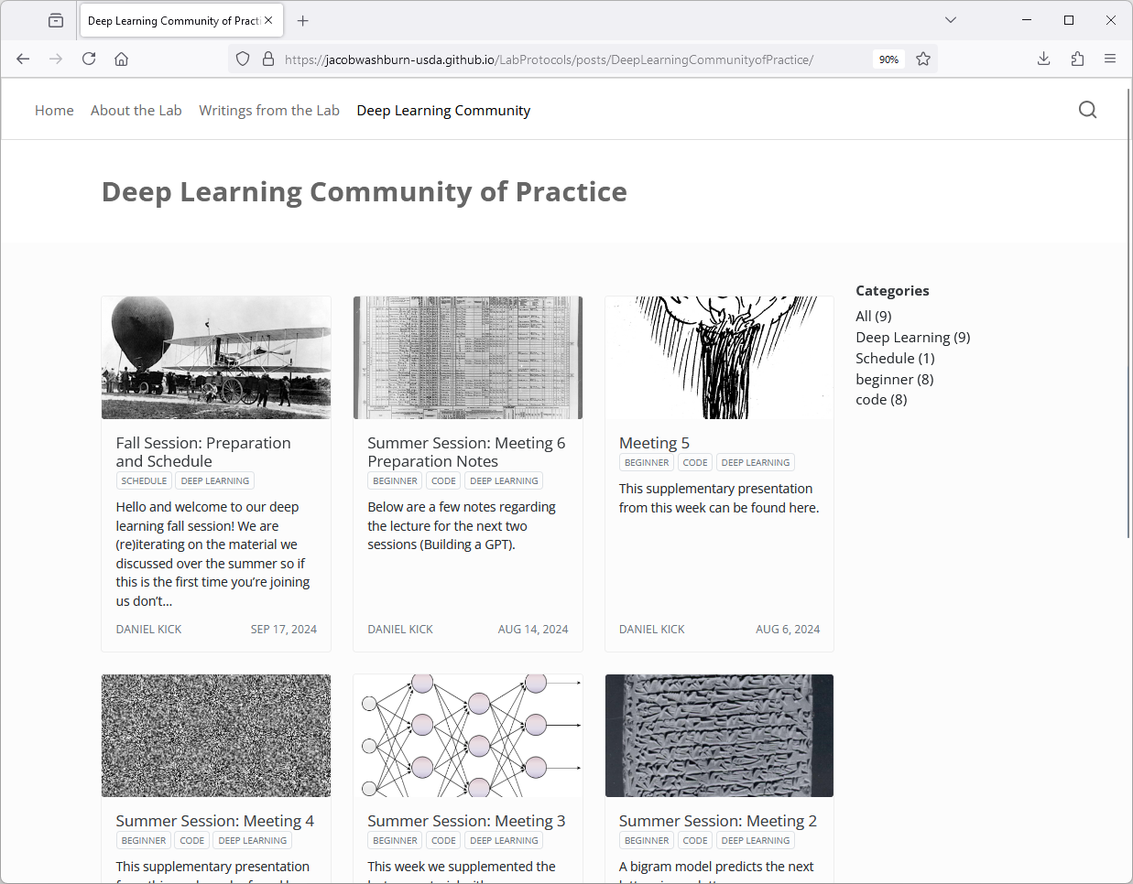
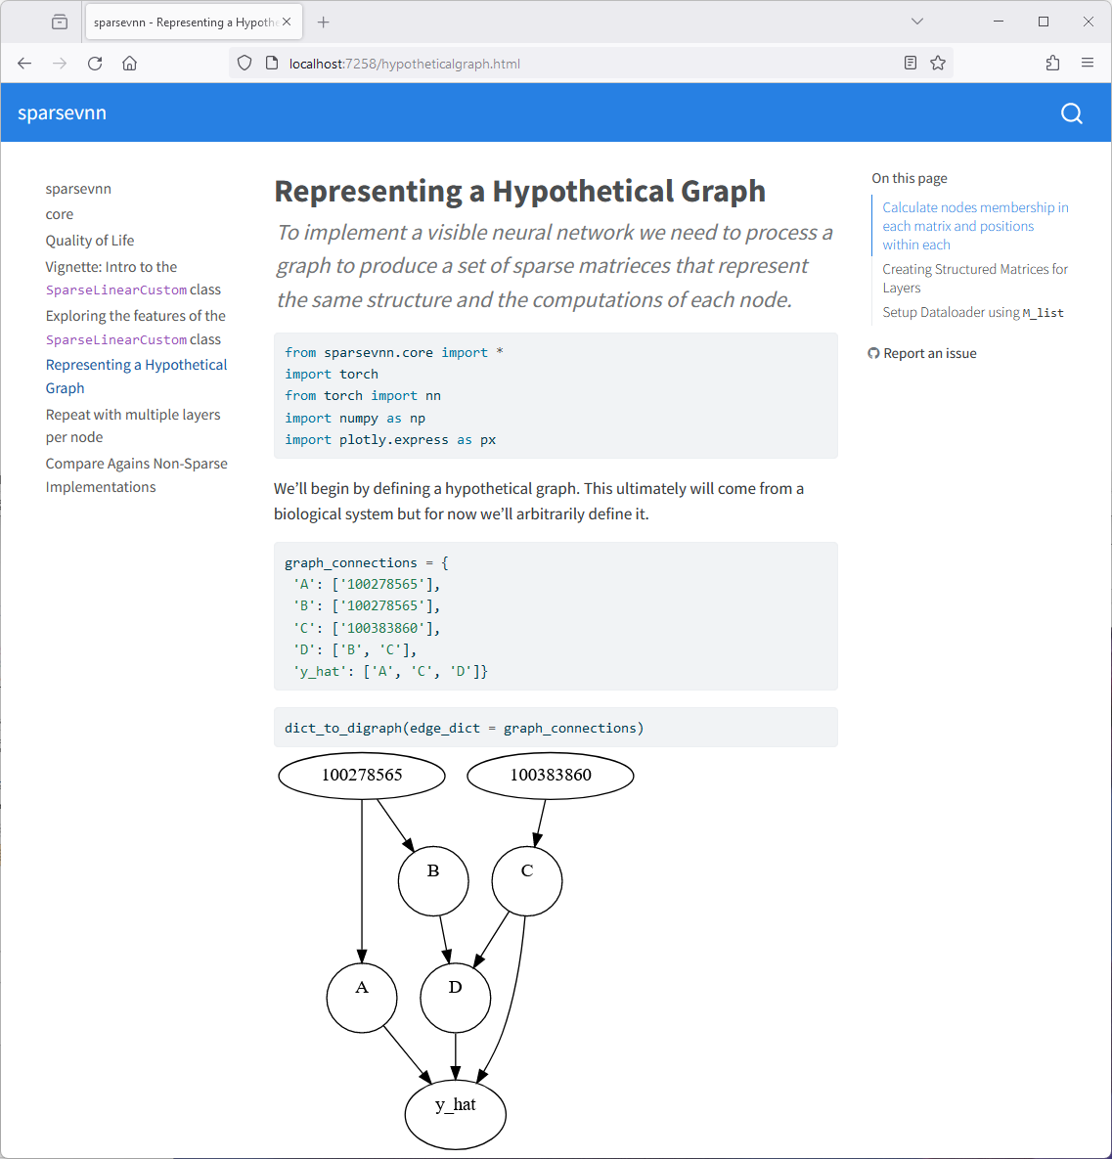
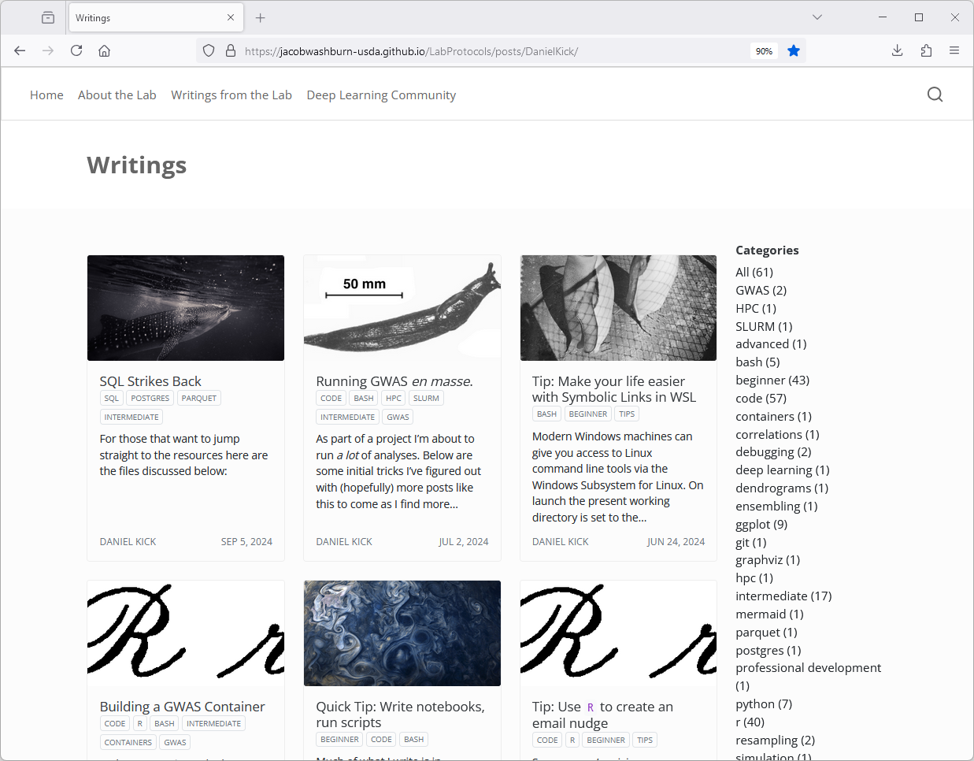
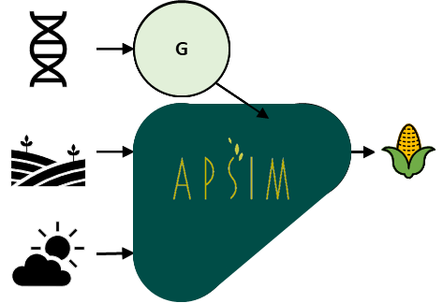
Personal Introduction
Molecular Neurophysiologist ➔ Research Geneticist
Trait Prediction Using Genomic and Environmental Data
Model interpretability
Software Carpentries Instructor

Slide 5
Thinking Questions
We’re covering Python and Deep Learning
How do you see yourself using these?
In the lab?
For personal use?
Both?
What application excites you most?
How small could you make this project?
When could you work on this?
What goals will you be better suited to achieve by learning these topics?

Slide 6
Overview
Month | Day | Before | Session | After | Deep Dive
Sept. | 24 | Pre-Meeting Setup | Python: Application
Oct. | 1 |  | Python: Fundamentals
Oct. | 8 |  | Python: Classes, Deep Learning Overview | What is a Neural Network? 0h18 , Gradient descent 0h20 , Analyzing our neural network
Oct. | 15 | What is backpropagation really doing? 0h12 , Backpropagation calculus 0h10, Backpropagation 2h25 | Discussion
Oct. | 22
Oct. | 29 | Bigram Language Model 1h57 | Discussion
Nov. | 5
Nov. | 12 | Multilayer Perceptron Language Model 1h15 | Discussion
Nov. | 19 |  | Journal Club: BatchNorm |  | Activations + BatchNorm 1h55
Nov. | 26 |  |  |  | Backpropagation Deep Dive 1h55
Dec. | 3 | But what is a GTP 0h27, Visualizing Attention 0h26 Generatively Pretrained Transformer 1h56 | Discussion | How might LLMs store facts 0h22 | WaveNet 0h56
Dec. | 10

Slide 7
Using Python for Science

Slide 8
Why Python? (Even if you know R)
There are bindings for R…
It’s easier?
It provides a different community with different strengths
It presents alternate ways of thinking about and articulating a solution
https://torch.mlverse.org/
https://posit.co/blog/tensorflow-for-r/

Slide 9
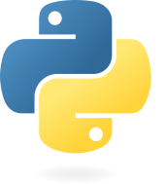
The Blup Paradox
It doesn’t even have
non-standard evaluation!
It doesn’t even have
dictionary comprehensions!
“not merely technologies, but habits of mind”
Languages fall along a continuum of abstractness … [consider a] hypothetical language called Blub. Blub falls right in the middle of the abstractness continuum.
As long as our hypothetical Blub programmer is looking down the power continuum, he knows he's looking down … because they're missing some feature he's used to. But when our hypothetical Blub programmer looks in the other direction, … he doesn't realize he's looking up. What he sees are merely weird languages. He probably considers them about equivalent in power to Blub, but with all this other hairy stuff thrown in as well. Blub is good enough for him, because he thinks in Blub.
https://paulgraham.com/avg.html

Slide 10
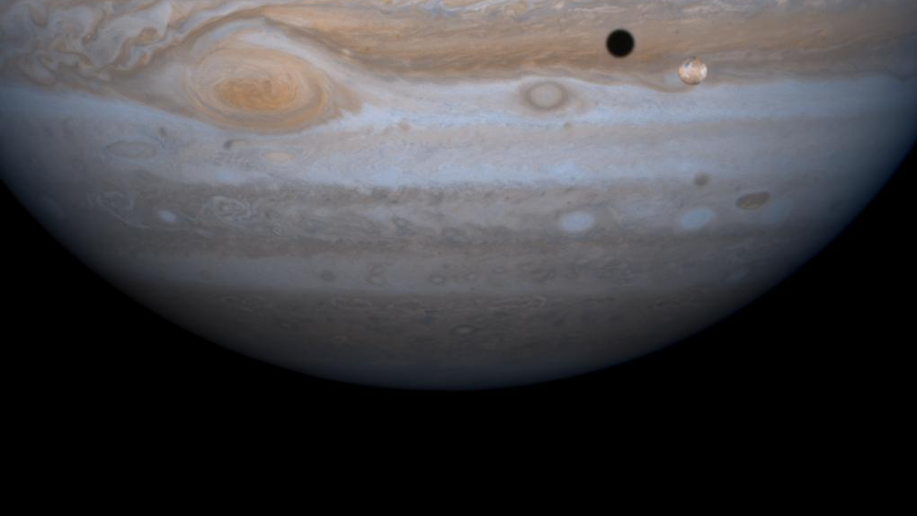
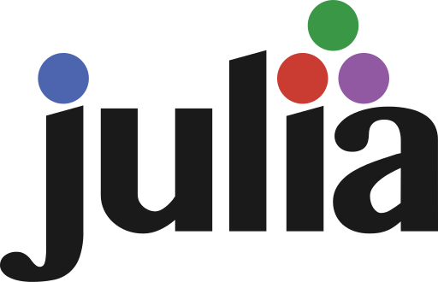
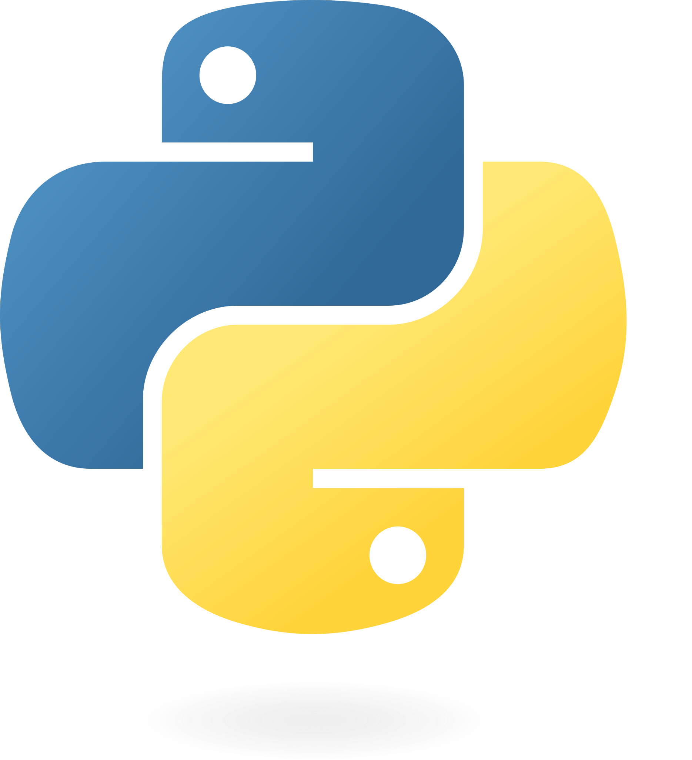
Tools and Techniques for a Jupyter Based Scientific Workflow
Image Credit: NASA

Slide 11
Goals for today:
Overview of a few tools that can enhance research
Easier to reproduce
More flexibility
Less tedious
Faster
References to help learn more
Hands on experience

Slide 12
Tasks
Write
Document
Communicate
Reproduce
Audit

Slide 13
Tasks
Write
Document
Communicate
Reproduce
Audit

Slide 14
Tasks
Write
Document
Communicate
Reproduce
Audit

Slide 15
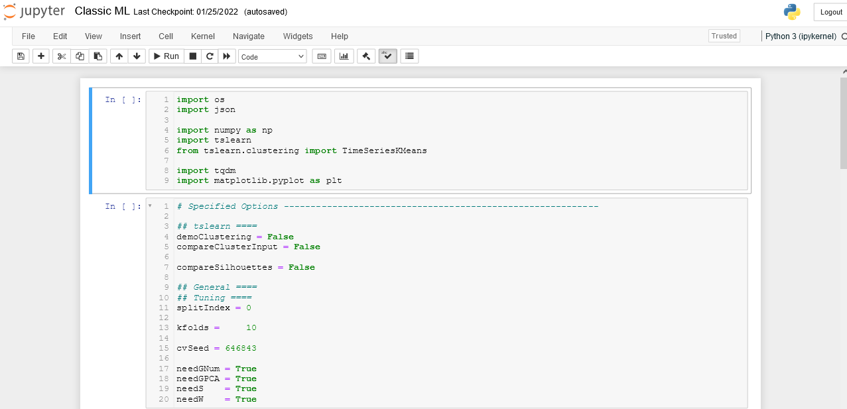
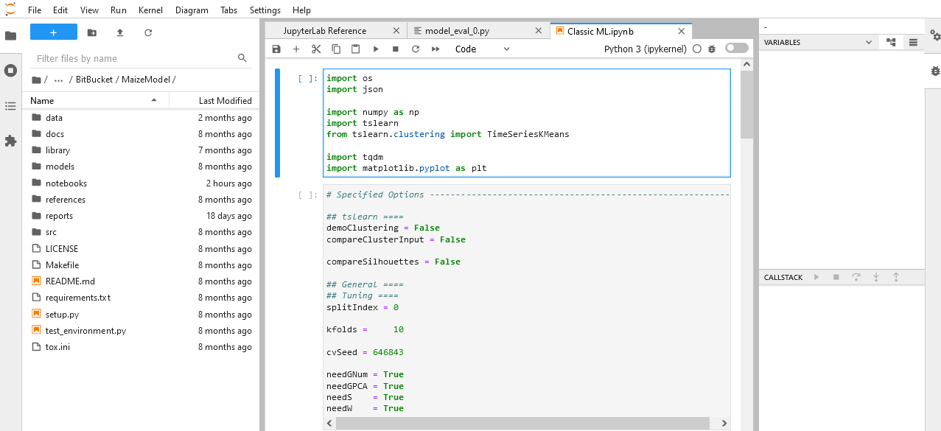
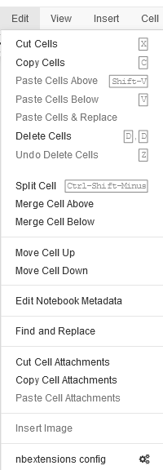
Notebooks
Jupyterlab
Multiple files (!)
File browser
Plugins
Debugger
Limited at first, but customizable through extensions
More feature rich out of the box, akin to Rstudio or PyCharm.
Both are good options.
Try both and don’t be hesitant to switch if you’re for a feature only one has.

Slide 16
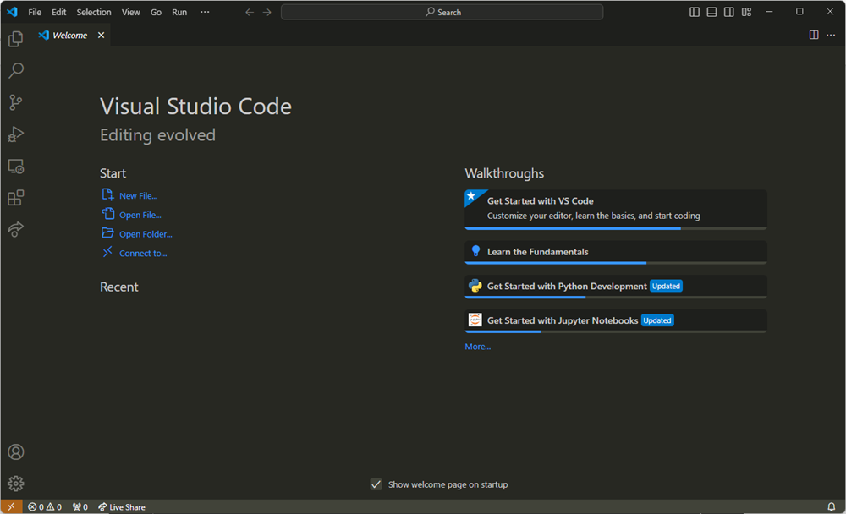
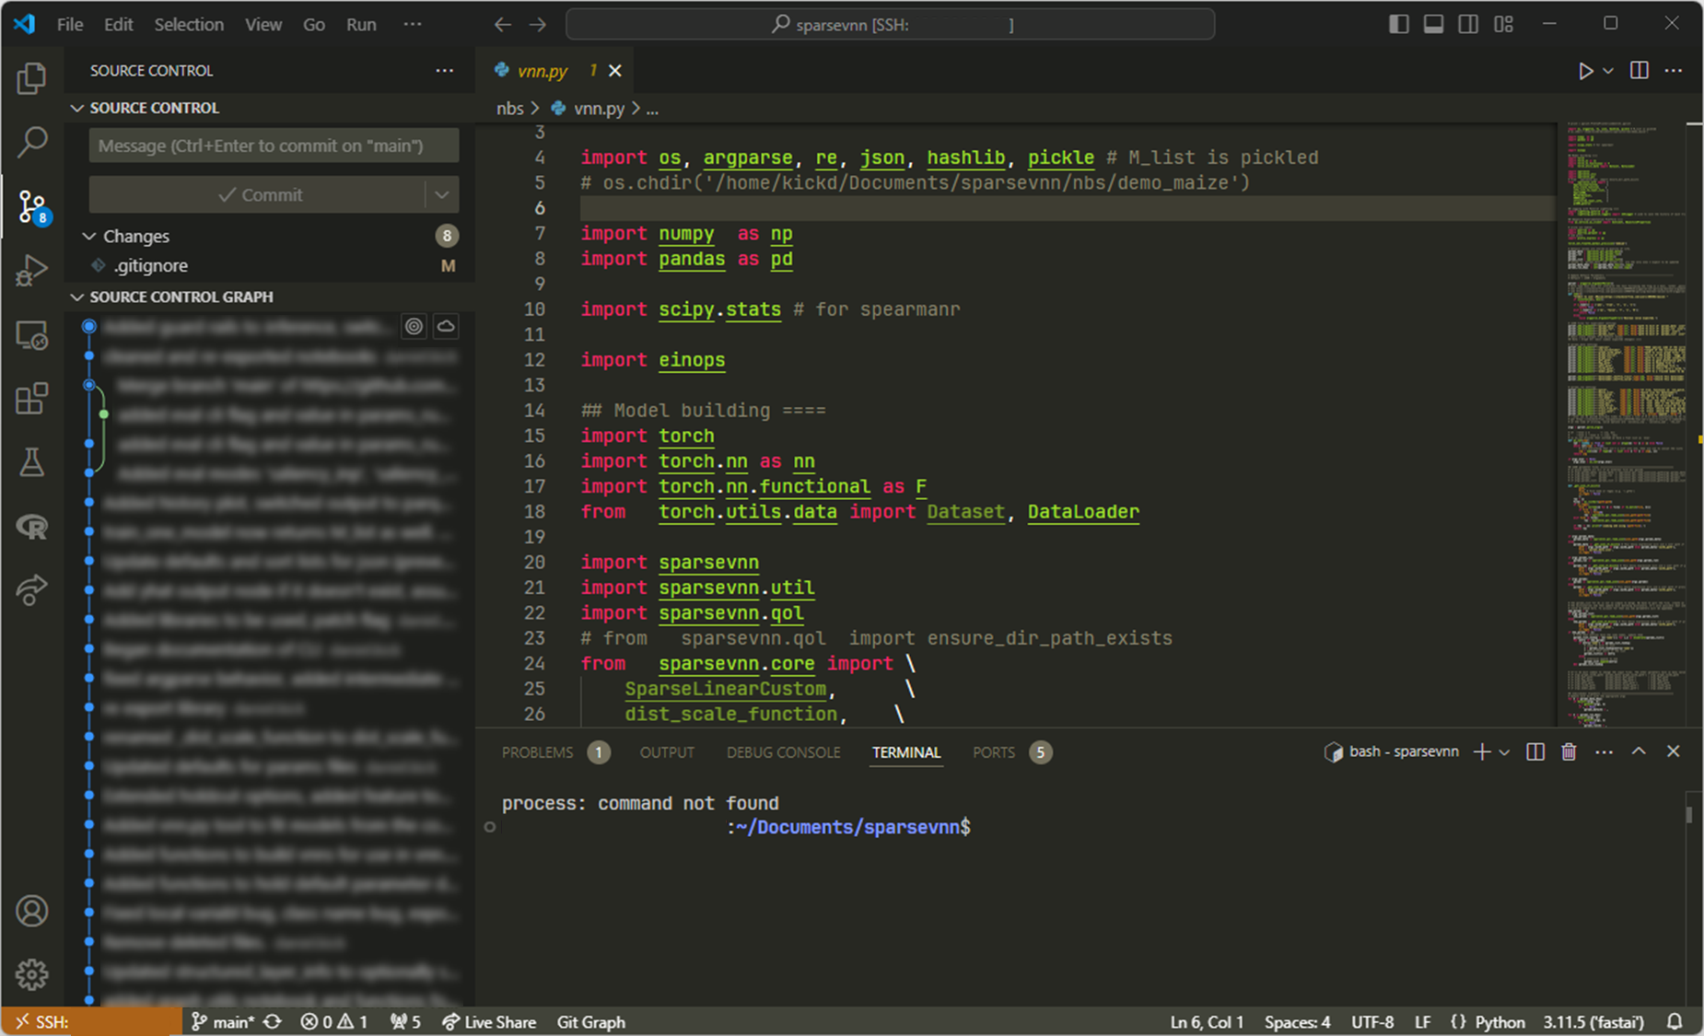
Extra Setup
version control (git)
collaboratively edit
shell
connect to remote (ssh)

Slide 17
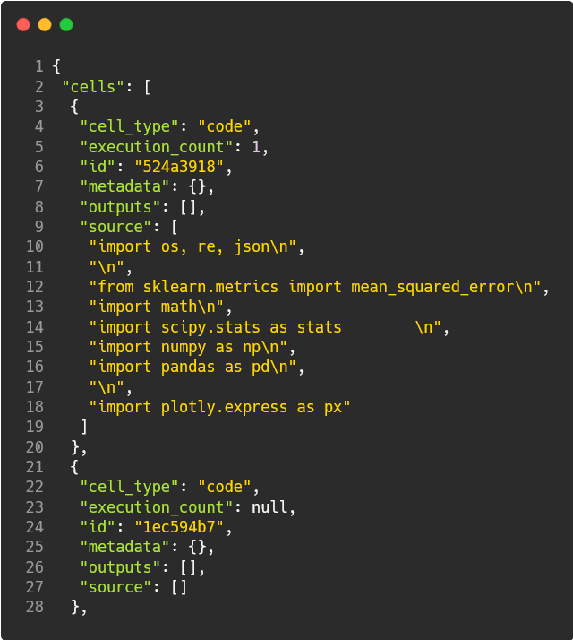
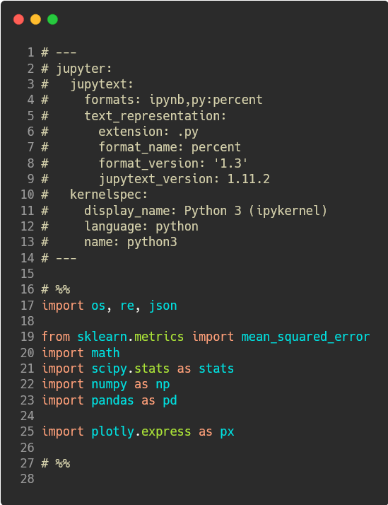
Using Jupyter Effectively
Find shortcuts for common tasks. (e.g. ctrl+/ → comment code)
Additions to consider:
Jupytext (automatically backs up foo.ipynb as foo.py , great for git)
Quarto
Organization
Table of Contents (2)
Collapsible Headings
Codefolding
View/Toggle Line Numbers
Writing
Autopep8 (auto format python code)
Spellchecker
Hinterland (code completion)
Presentations
RISE (html slides, works with plotly)

Slide 18
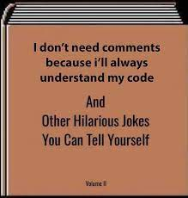
Useful Habits
Your closest collaborator is yourself – six months ago
Libby King (paraphrased)
Code should focus on being clear first.
Writing out what your code needs to do is a great way to plan while documenting your code.
Markdown blocks (esc+M) are good way to break up code with human readable headings and explanation
Err on the side of writing too many comments.
The “why” and “how” of the code. Eventually may shift towards concepts from mechanics.

Slide 19
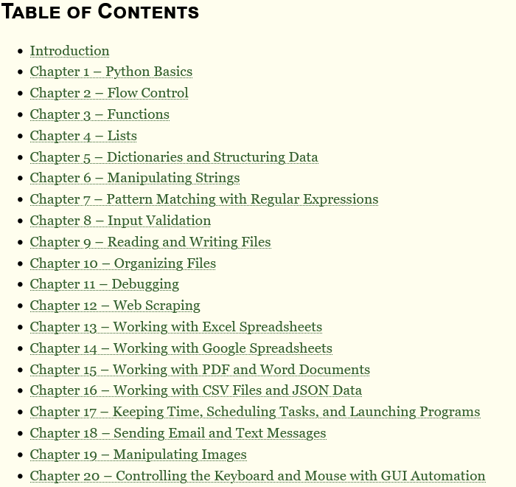
Getting help
Tutorials
Learn X in Y minutes
Automate the Boring Stuff
Software Carpentry
Data Carpentry
Official Tutorial
Specific Questions
Stack Overflow
Lab members!

Slide 20
Tasks
✔
Write
Document
Communicate
Reproduce
Audit
✔

Slide 21
Visualization occurs throughout analysis
Quickly see the effect of changes code
Leverage visual intuition to spot patterns/outliers
Source: Autodesk

Slide 22
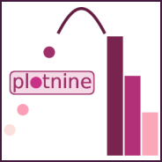
Comparing Python Graphing Libraires
Great for interactive figures
Bindings for python, R
Allow for interaction at a high level (figure factory, plotly express) and a low level (graph objects)
plotly
Seaborn is built on matplotlib.
Great for statistical plots -- if they have what you want.
seaborn
Great for very simple and very complex plots
matplotlib
Fans of ggplot2 can use plotnine which operates almost identically

Slide 23
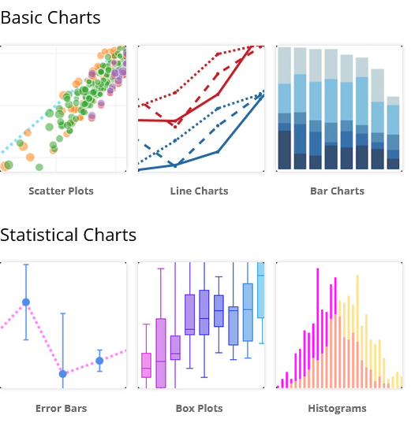
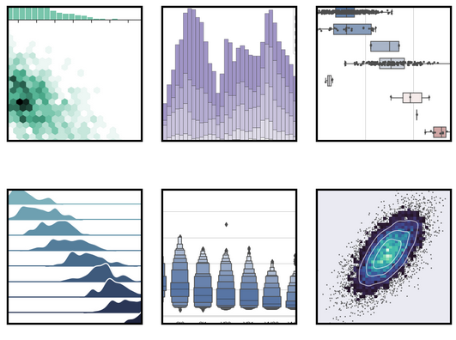
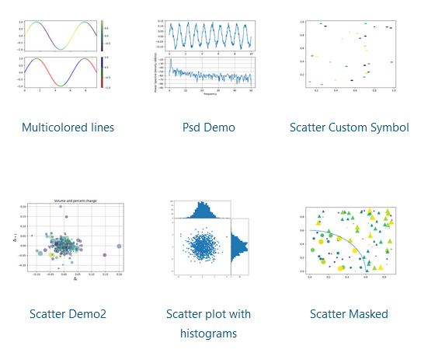
Comparing Python Graphing Libraires
High and low level controls provides
a nice balance of customization and
Speed.
Very nice out of the box but
customization requires mpl
Highly customizable but not
particularly user friendly*
*ymmv, relative to ggplot2

Slide 24
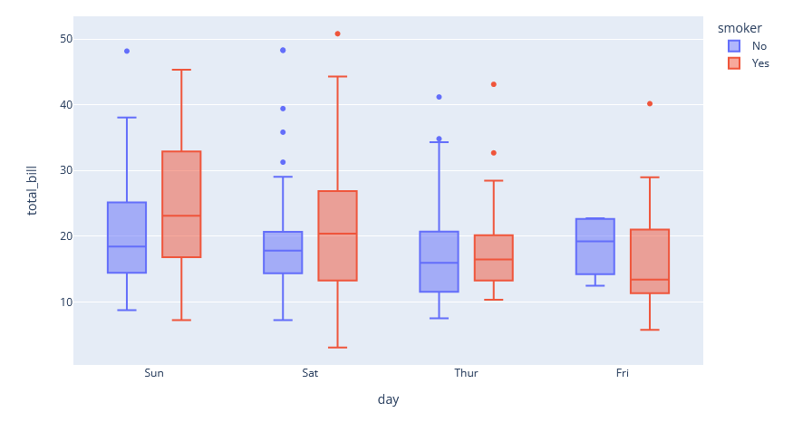
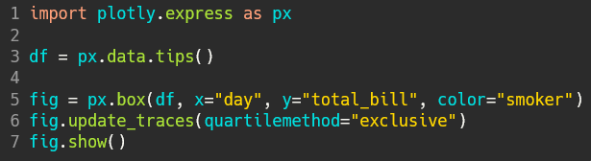
Plotly – Getting started
Choose a chart
Copy the example code
Test the example on your machine
Swap in your variables and data.

Slide 25
In Practice:
`bears` DataFrame
Type
Lon
Lat
Diet
0
Brown
1
Panda
2
Polar
3
Panda
4
Polar
location
Rows where
Type is ‘Pandas’
Column index all
https://pandas.pydata.org/docs/getting_started/intro_tutorials/
Images from https://pandas.pydata.org/docs/getting_started/intro_tutorials/03_subset_data.html

Slide 26
In Practice:
`bears` DataFrame
Type
Lon
Lat
Diet
0
Brown
1
Panda
2
Polar
3
Panda
4
Polar
location
Row index all
Column index Lon, Diet
https://pandas.pydata.org/docs/getting_started/intro_tutorials/
Images from https://pandas.pydata.org/docs/getting_started/intro_tutorials/03_subset_data.html

Slide 27
In Practice:
`bears` DataFrame
Type
Lon
Lat
Diet
0
Brown
1
Panda
2
Polar
3
Panda
4
Polar
Row index where
Type is Panda
location
Column index Type, Diet
https://pandas.pydata.org/docs/getting_started/intro_tutorials/
Images from https://pandas.pydata.org/docs/getting_started/intro_tutorials/03_subset_data.html

Slide 28
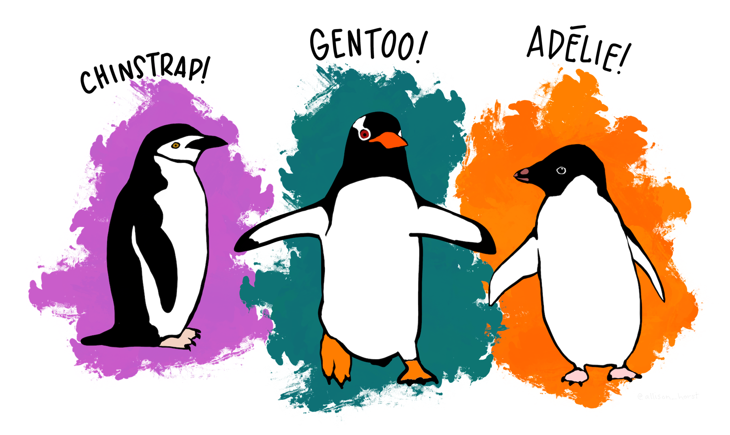
Plotly – Digging Deeper
Plotly express – Main interface
Figure factory – Specialized figures built from graph objects
Graph objects – More detailed control of plots
Palmer Penguins

Slide 29
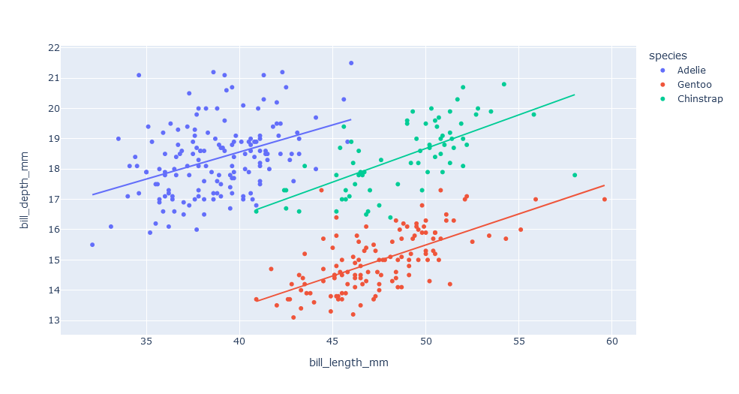
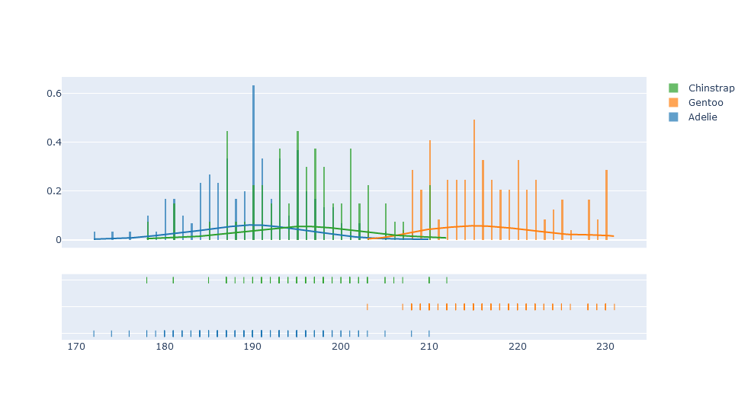
Plotly – Digging Deeper
Plotly express – Main interface
Figure factory – Specialized figures built from graph objects
Graph objects – More detailed control of plots
Palmer Penguins

Slide 30
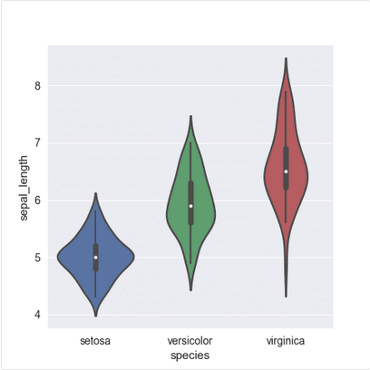
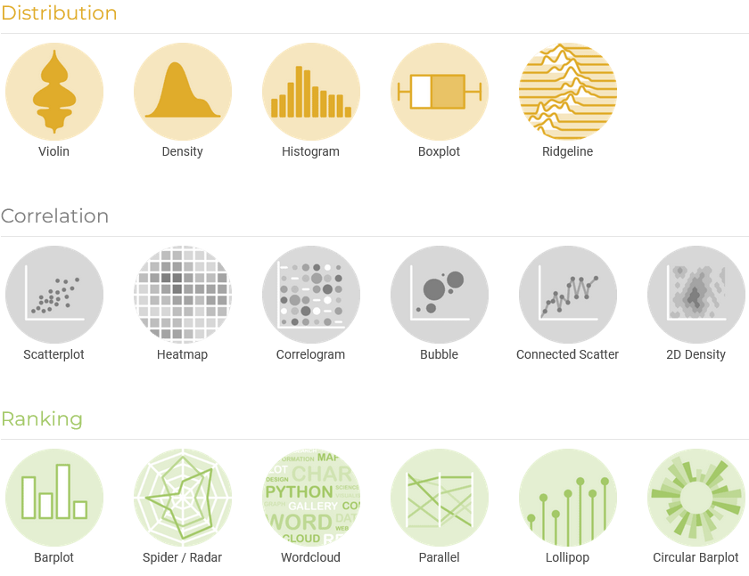
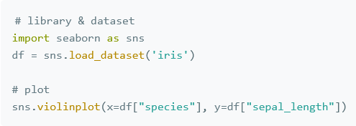
Other resources
Python Graph Gallery

Slide 31
Tasks
✔
Write
Document
Communicate
Reproduce
Audit
✔
✔

Slide 32
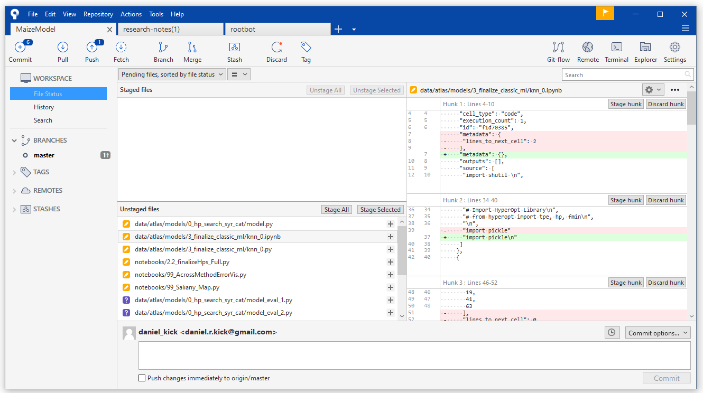
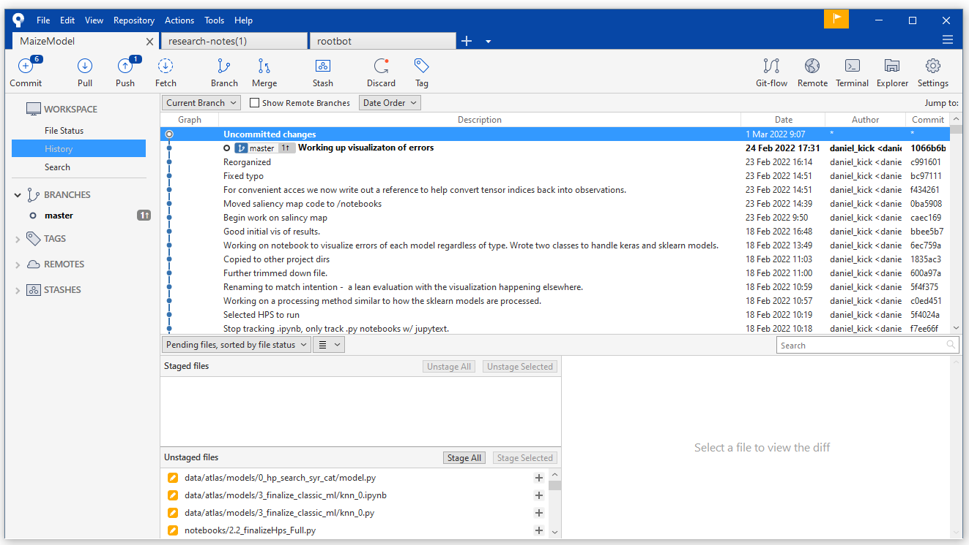
Git
Changes
(this is why paired notebooks are useful)
Backup snapshot
Track changes + backup
Useful even if you’re the only one working on a project
Ways to track packages in addition to code
Virtual environments
Conda virtual env
Docker/Singularity
Scinet Overview
Files with changes
New files not yet tracked
Capture a “snapshot”
Description of what changed
History of snapshots

Slide 33
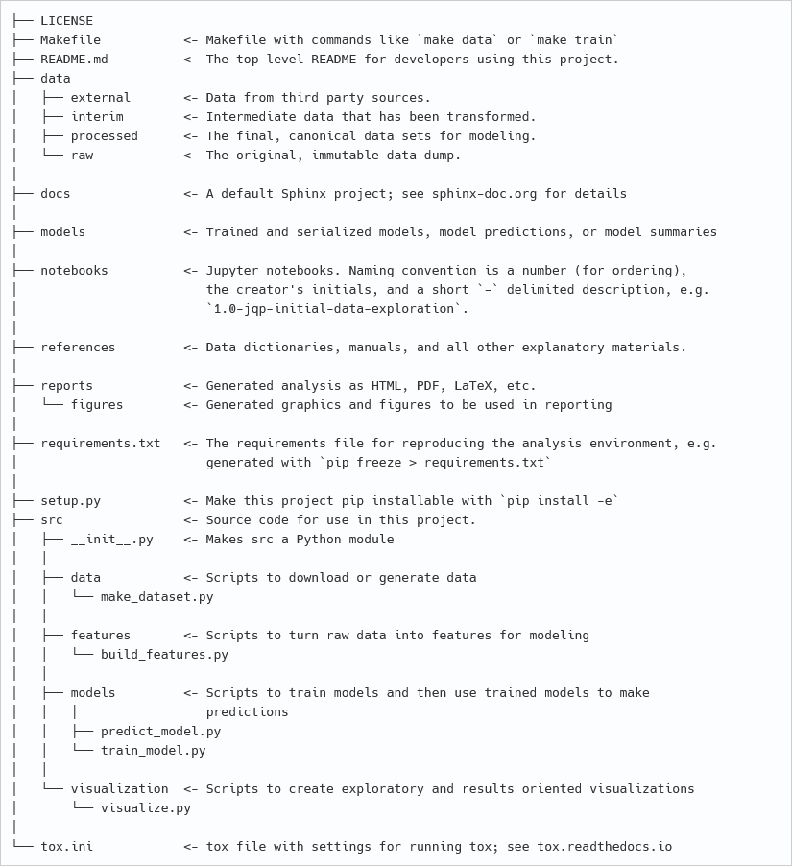
Think about the project structure before starting
Cookiecutter data science structure
R packages or similar
The more moving parts the more important this is.

Slide 34
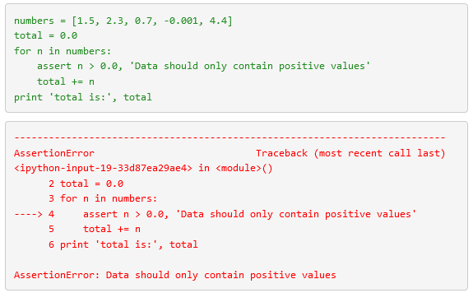
Assertions
“It ain’t what you don’t know that gets you into trouble. It’s what you know for sure that just ain’t so.”
Defensive Programming
More Formal options:
Great Expectations (data)
Hypothesis

Slide 35
Tasks
✔
Write
Document
Communicate
Reproduce
Audit
✔
✔
✔
✔

Slide 36
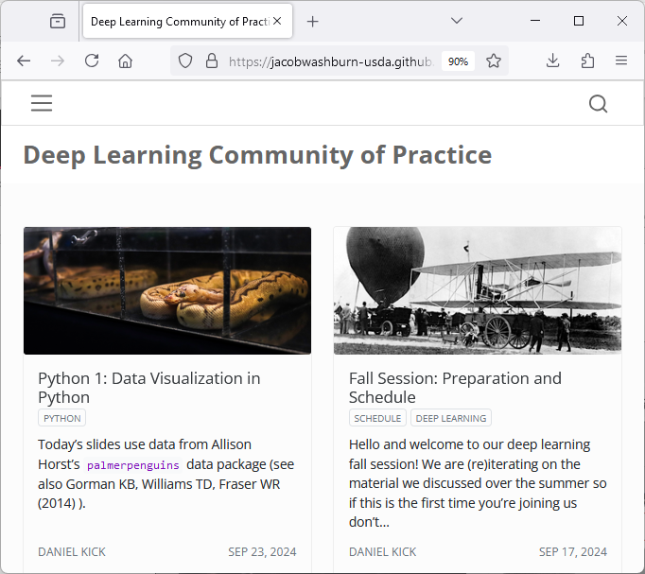
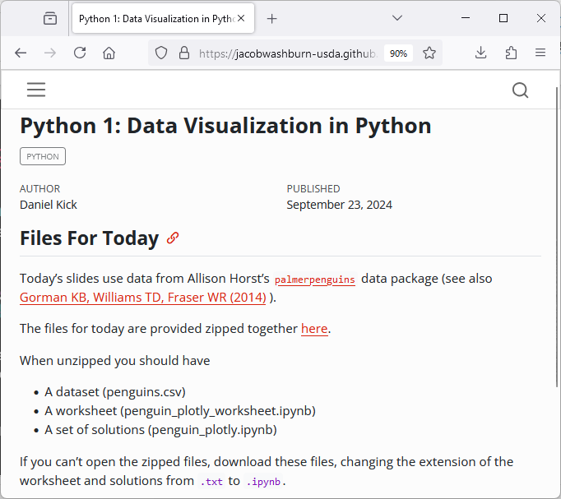
Applying what you’ve learned:

Slide 37
Applying what you’ve learned:
Time Permitting:
See visualization of Palmer Penguin dataset in practice
In pairs:
Choose a dataset
Decide on a visualization
Make it
Share your visualization with the group
How did you decide on the plot type? What does it reveal?
Palmer Penguins

Slide 38
Image Credit: NASA

