Slide 1
Deep Learning Community of Practice Python Fundamentals
Daniel Kick, Coordinator

Slide 2
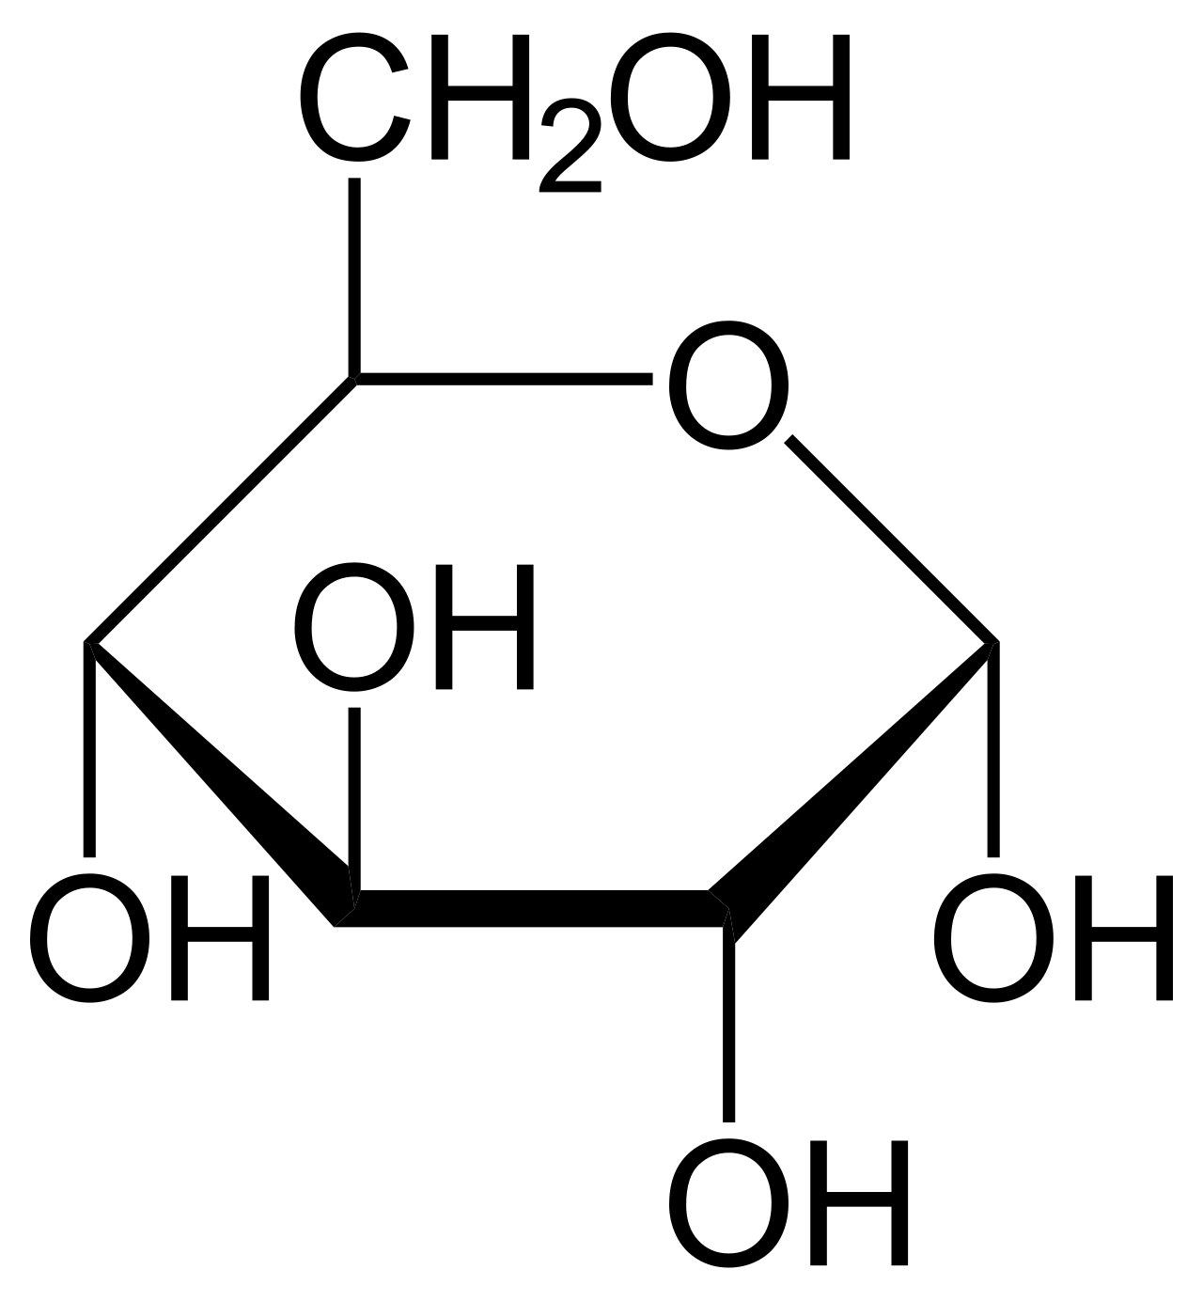
Organizational Map
High Level
type(1) == int
type(1.0) == float
type('text') == str
Data types
Last Session
Visualizations
Collections
Indexing
Conditionals
Looping
Functions
Classes
species | bill_mm | flipper_mm
--------+---------+-----------Adelie | 39.1 | 181 Adelie | 39.5 | 186 Adelie | 40.3 | 195 Gentoo | 46.1 | 211 Gentoo | 50.0 | 230 Gentoo | 48.7 | 210 Chinstr | 46.5 | 192 Chinstr | 50.0 | 196 Chinstr | 51.3 | 193
Data Frames
This Session
Matrices
bespoke(data = penguin
).FILTER(species = ['Adelie']
).SELECT(col='bill_length_mm'
).MEAN()
> 39.63333333333333
Data Frame with basic operations
Low Level
Atomic Datatypes, Basic operations

